Slide 1
NGSS in the Garden
Crystal Howe - San Diego County Office of Education

Slide 2
Agenda
An example lesson.
Lesson debrief
The 3D
Phenomena
5E
Getting outside with NGSS

Slide 3
CA Science Framework
Children are born investigators.
Understanding builds over time.
Science and engineering require both knowledge and practice.
Connecting to students’ interests and experiences is essential to learning.
All students deserve access to strong science experiences.
Notes:
Assumptions of NGSS we see in the framework introduction

Slide 4
Let’s Try a Garden Lesson
Notes:
Watch the clip.
What do you observe?
What do you wonder?

Slide 5
Garden Science Notebooking
Engage
Use your notebook (paper), at least 2 colored pencils, and a regular pencil.
Wander the plants and observe them using your senses of smell, sight, hearing, and gentle touch.
Choose a plant to investigate. Draw, write, and measure for at 3 minutes.
Notes:
Instructions:
In the middle of your page draw a view of your subject that is exactly life size. If the object is larger than your page, only draw part of it. Add some written notes. Then choose some part of the subject that you find interesting and draw a little circle around that part of your drawing. At the side of the paper, draw a larger circle and draw a magnified view of that same area showing details that are too small to be shown in the life size picture. Include written notes. Finally, take a few steps back from the plant and make a final sketch, this time zoomed out to take in the whole plant, and some of its environment. Use both writing and drawing. We are looking from three levels of focus, life size, a magnified view, and a more distant view, all on the same page. Now let’s see what you observe by changing your level of focus.
Time the group.
Have participants share how the experience felt, what they noticed, how scale affected their observations and evidence.
Lakeside addition - Partners find one anothers plant

Slide 6
Add to your drawing
Use the lens of scale, proportion, and quantity to add to your observations, drawings, and ask questions about your plant.
Life size plant (circle an area to magnify)
The plant and its some of its environment
Magnified view of a circled area
Notes:
5 min.
Instructions:
In the middle of your page draw a view of your subject that is exactly life size. If the object is larger than your page, only draw part of it. Add some written notes. Then choose some part of the subject that you find interesting and draw a little circle around that part of your drawing. At the side of the paper, draw a larger circle and draw a magnified view of that same area showing details that are too small to be shown in the life size picture. Include written notes. Finally, take a few steps back from the plant and make a final sketch, this time zoomed out to take in the whole plant, and some of its environment. Use both writing and drawing. We are looking from three levels of focus, life size, a magnified view, and a more distant view, all on the same page. Now let’s see what you observe by changing your level of focus.
Time the group.
Have participants share how the experience felt, what they noticed, how using the CCC of scale affected their observations and evidence.

Slide 7
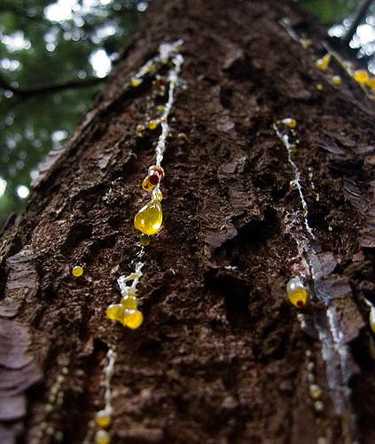
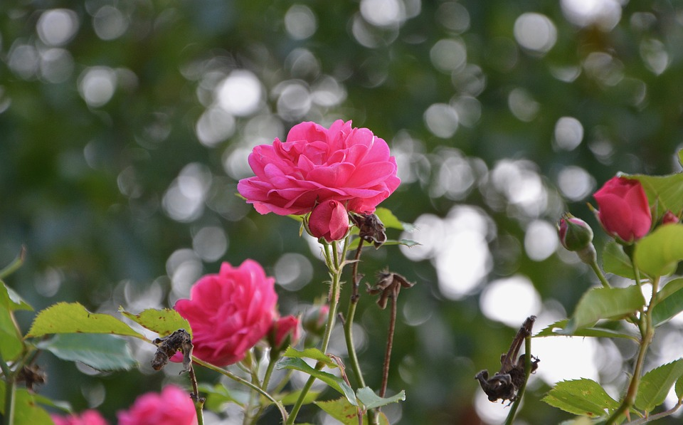
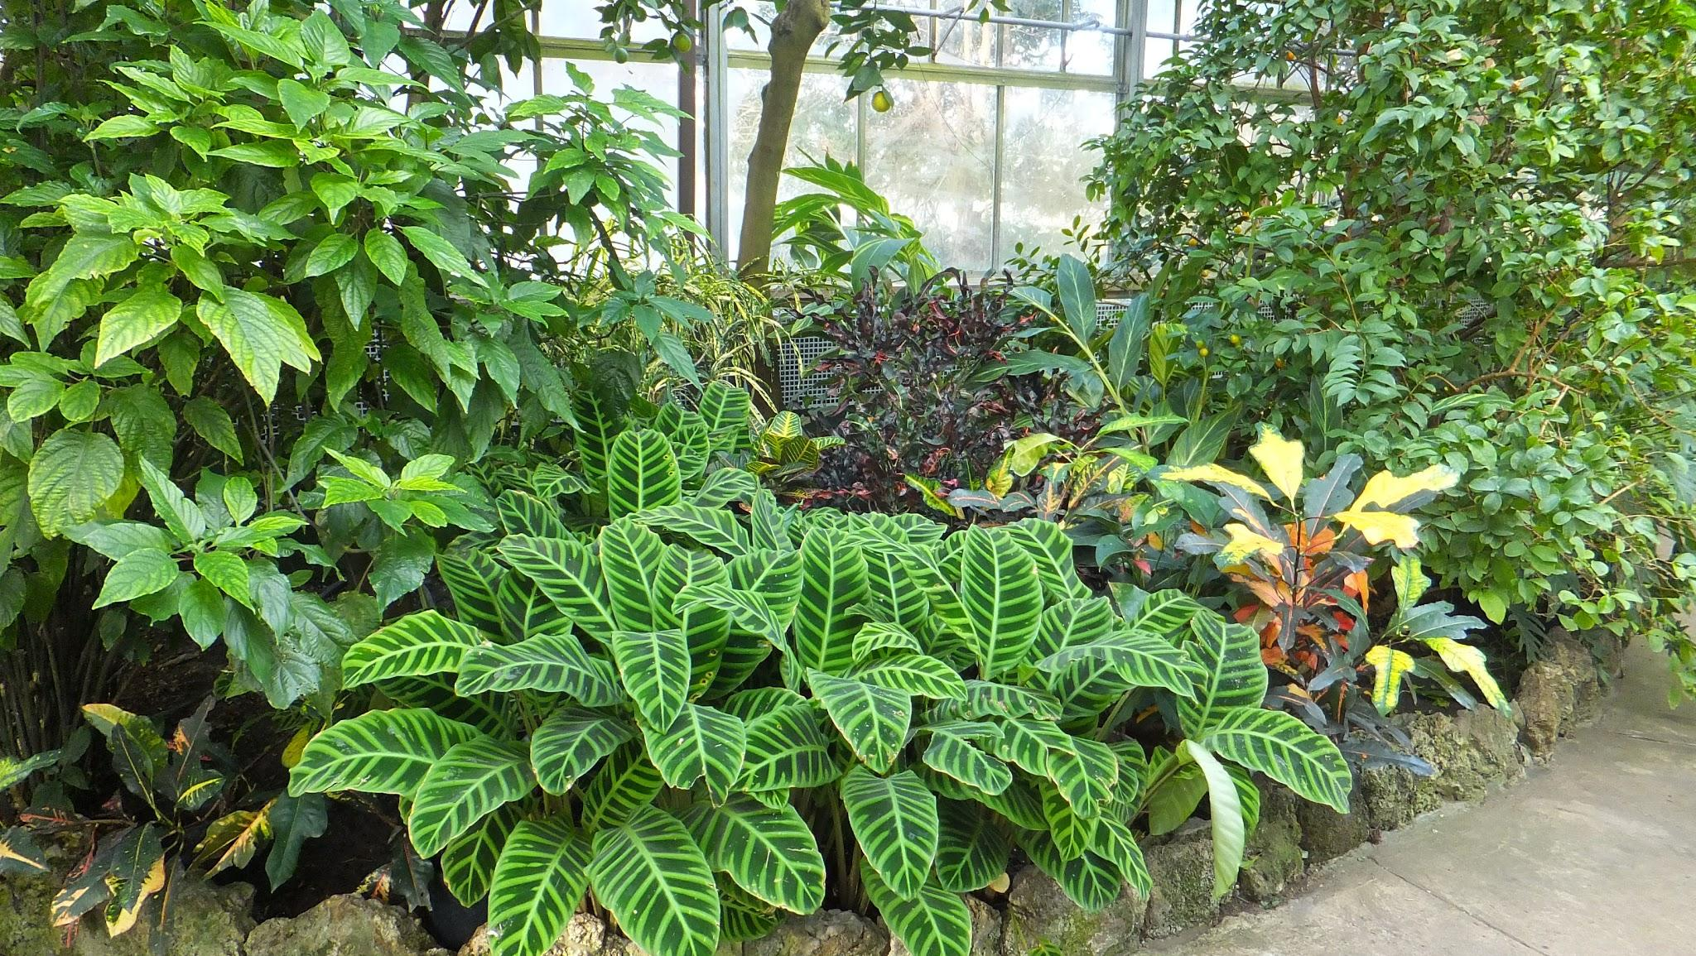
Plant Stations
Chemical
Bark
Thick leaves
Thorns
Hairs
Sap
Spines
Notes:
Actually seeable, touchable
A specific need is defenses.
Station Directions → Physical actually do it
Chemical/Symbiotic gets videos → Asking question tie in
spicy
Leaf litter - picture
Sage
cinnamon
EXPLORE/EXPLAIN

Slide 8
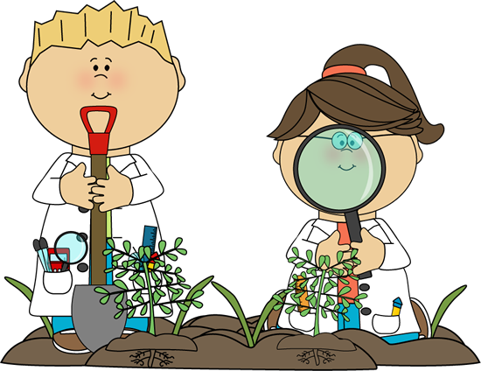
Plant Stations
Explore
Make observations using your senses, notes and drawings of the plant at each station.
Talk to your team about:
What structures you notice on the plants.
What the structures help the plants to do.
What you already know about the plants.
What questions you have about the plants.
Notes:
Think about the

Slide 9
Plants Stations
Explain
Discuss with your team:
What plant structures did you observe?
What plant needs did you identify?
Why do plants need different structures to fulfill the same need?
Notes:
Back at tables

Slide 10
Plant Defenses
Elaborate
Read the Plant Defenses book.
★ | Any plant defense you saw at the stations.
! | Anything new you learned from the reading.
? | Areas you have questions about.

Slide 11
Back to the Phenomena
Notes:
Watch the clip.
What plant need is this action/structure fulfilling? What evidence do you have for that? What other questions do you have or information would you want to know?

Slide 12
Lesson Debrief

Slide 13
The Goal of NGSS
Students engage in Science and Engineering Practices to discover or explore phenomena (Disciplinary Core Ideas) while developing a scientific mindset (Crosscutting Concepts).
Notes:
We call this 3 dimensional learning. Here are the three dimensions on one page. Check them out, what looks familiar, what looks different?

Slide 14
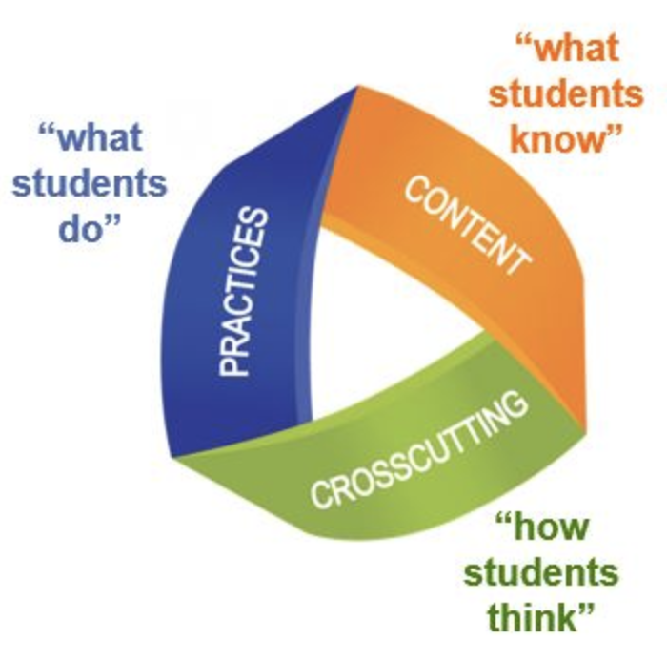
Lesson Debrief
How is this lesson 3 dimensional?
Science and Engineering Practices
Crosscutting Concepts
Disciplinary Core Ideas
Notes:
3 D handout

Slide 15
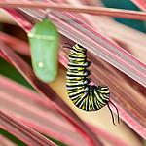
Phenomena
Scientific phenomena are occurrences in the natural and human-made world that can be observed and which cause one to wonder and ask questions.
Notes:
What phenomena might students be able to explore in the garden? Turn and talk. Share out.

Slide 16
Lesson Debrief
How was the phenomenon used in the lesson?
What other phenomena could have been used with this same activity?

Slide 17
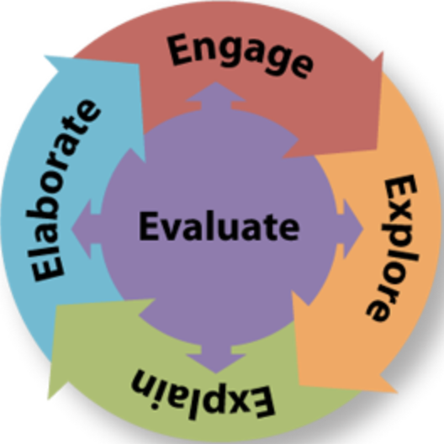
Lesson Debrief
How did the 5E format allow for an NGSS experience?
Which parts of the lesson matched each E?
Notes:
5E handout

Slide 18
The reality of using the garden
What challenges arise when you think about planning NGSS lessons in the garden?
What solutions do you have to these challenges?
Notes:
Group talk

Slide 19
What to try in the Garden
Talk to your partner:
What phenomena might you use to try on lessons in the garden?
Are some phenomena stronger for native gardens?
Are some phenomena stronger for vegetable gardens?
What kind of phenomena could the rest of the schoolyard provide?
Three Sisters Play
Notes:
Turn and talk.
Share out.
Choose one phenomena to try → make a sticky and write it down.

Slide 20
Why Go Outside?
An overarching goal of the NGSS is that “all students have some appreciation of the beauty and wonder of science; possess sufficient knowledge of science and engineering to engage in public discussions on related issues;… and have the skills to enter careers of their choice...”
(NRC 2012a, p. 1).
Notes:
Read the quote from the national research council framework for NGSS. How does using the garden allow students and teacher to achieve this goal of NGSS?

Slide 21
Thank you!
Any questions?
Crystal Howe
crystal.howe@sdcoe.net
ngss.sdcoe.net
Notes:
Slide template credit:
Presentation template by SlidesCarnival
Photographs by Unsplash

