Slide 1
IDENTIFYING PESTS AND THEIR MANAGEMENT

Slide 2
TYPES OF PESTS
Mollusks and Crustaceans
Arthropods (Insects)
Mammals

Slide 3
MOLLUSKS

Slide 4
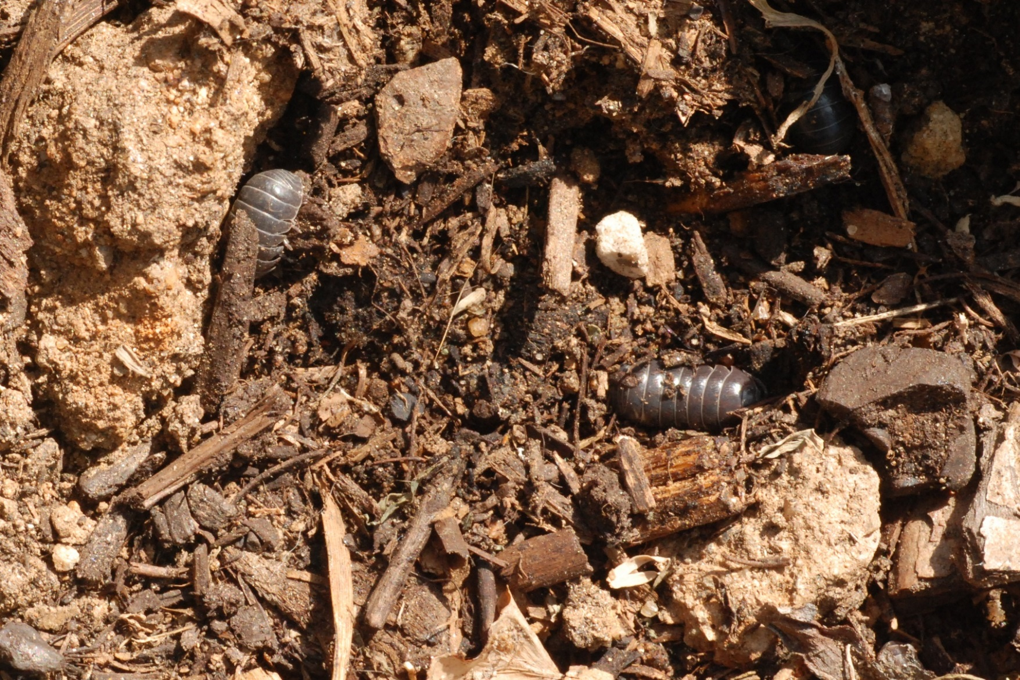
CRUSTACEANS

Slide 5
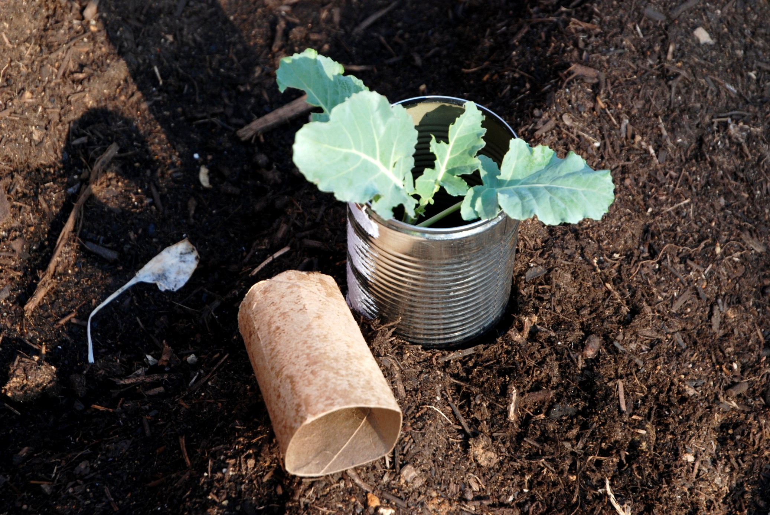

Slide 6
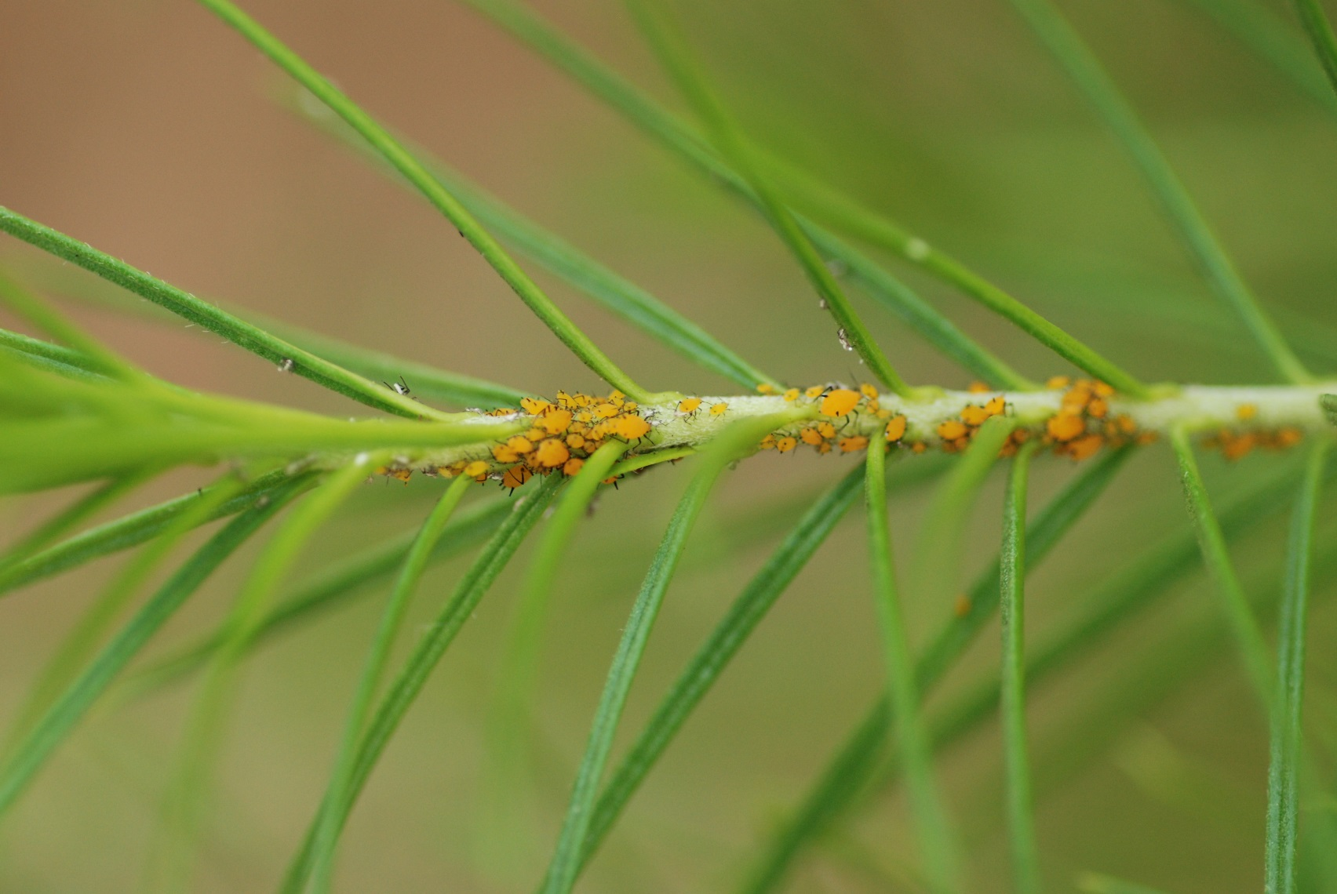
CHEWING AND SUCKING INSECTS

Slide 7
APHIDS

Slide 8
Spider Mites
Whiteflies
Magnified Spider Mite
Mealybugs

Slide 9
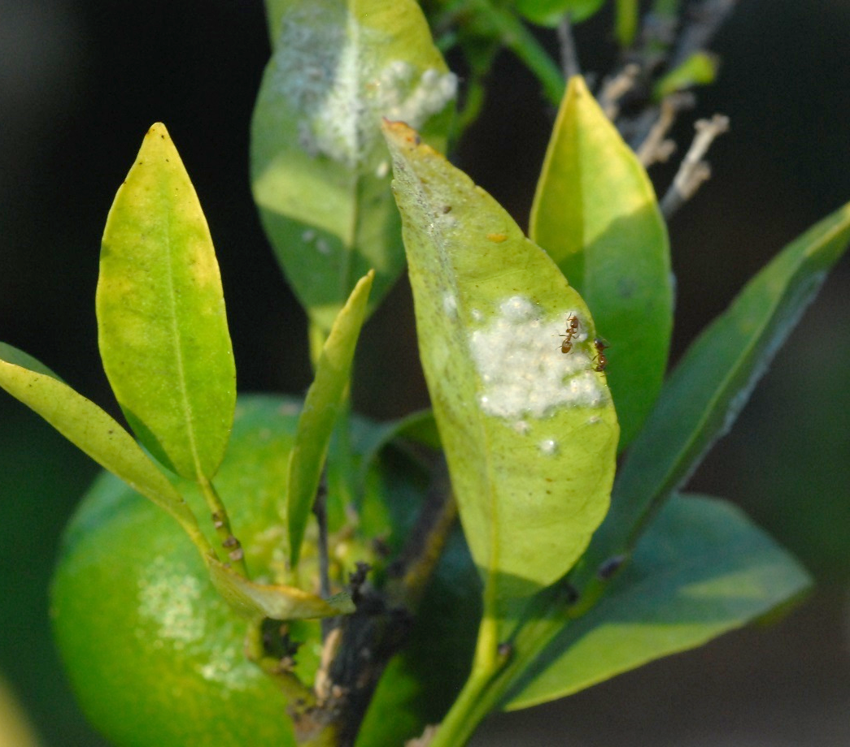
TO CONTROL YOUR HONEYDEW PRODUCING INSECTS, YOU MUST CONTROL YOUR ANTS

Slide 10
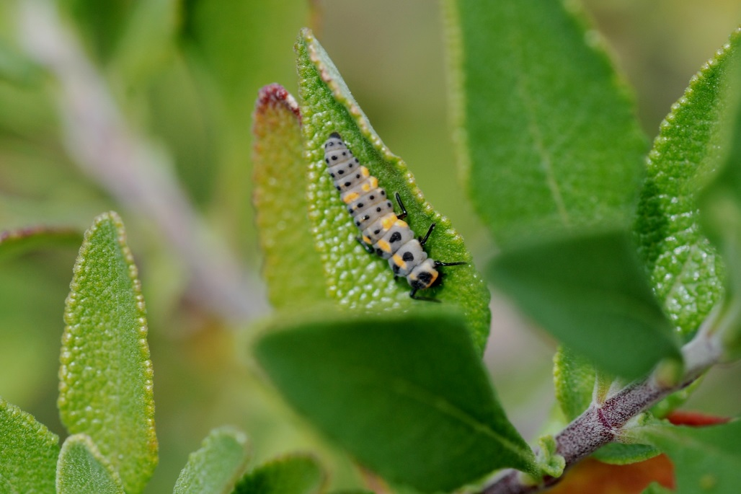
ENCOURAGE BENEFICIALS
Ladybug
Lacewing
Ladybug larvae

Slide 11
MEALY BUG DESTROYER LARVA

Slide 12
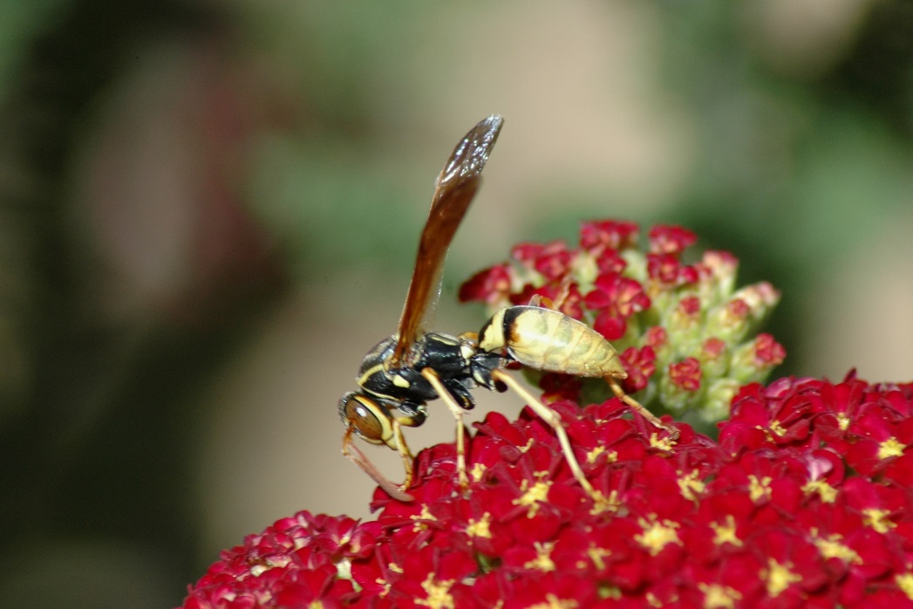
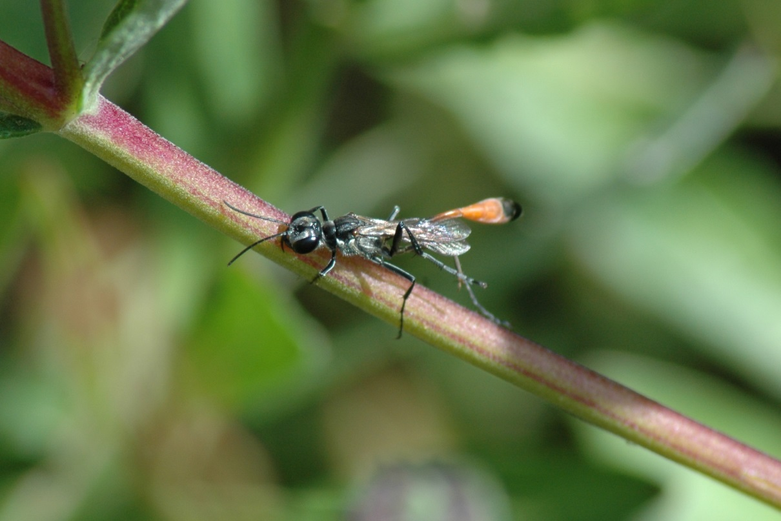
OTHER PREDATOR INSECTS
Assassin Bug
Various Wasps
Various Wasps

Slide 13
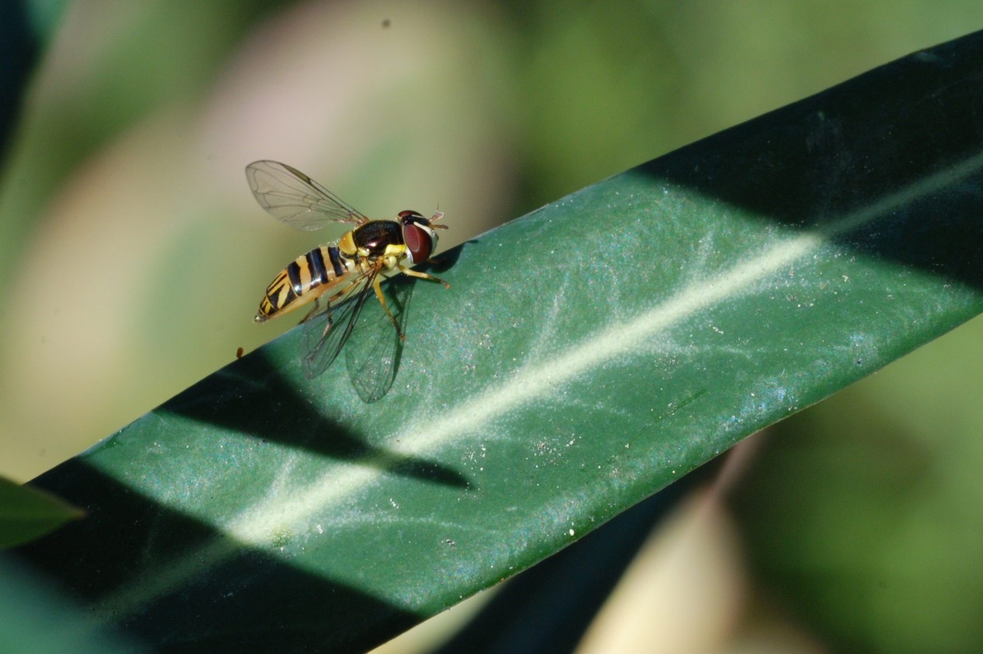
SYRPHID OR HOVER FLY
Syrphid or Hover or Flower Flies

Slide 14
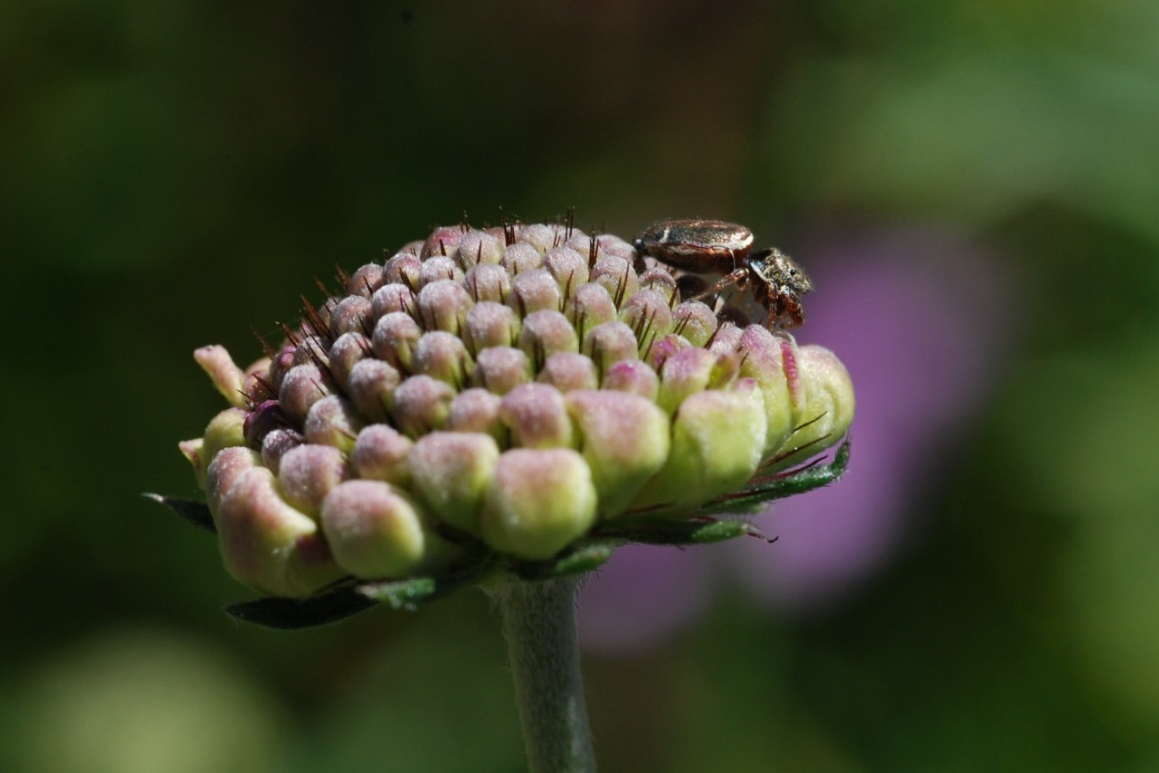
Predator
Spiders
Crab Spiders
Crab Spiders
Jumping spiders

Slide 15
Cabbage Looper
Corn Earworm on Tomato
Tomato Hornworm
Corn Earworm on Corn

Slide 16
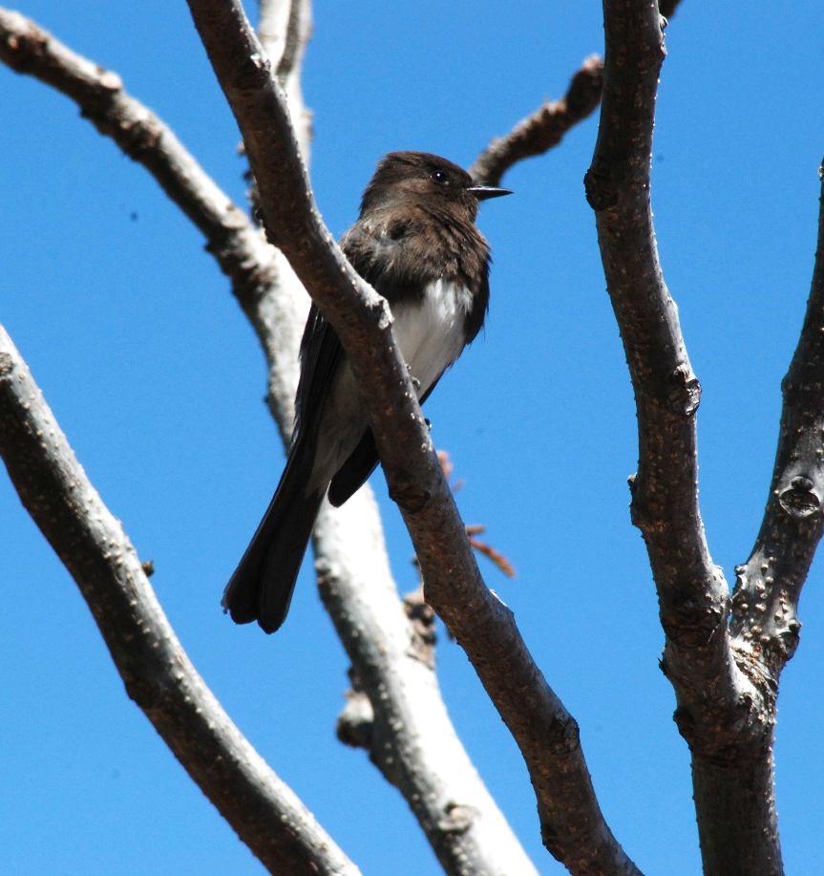
ENCOURAGE INSECT EATING BIRDS
House Wren
Black Phoebe

Slide 17
Use of Mechanical Means

Slide 18
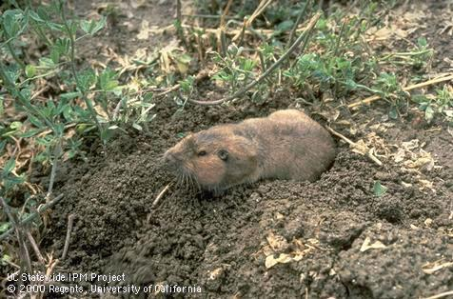
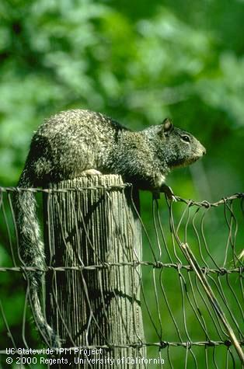
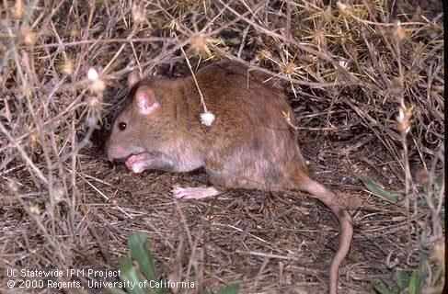
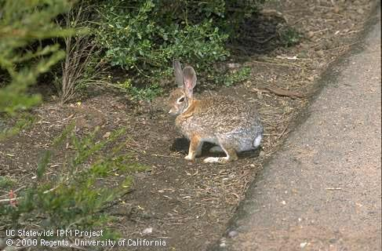
MAMMALS
Pocket Gopher
Ground Squirrel
Rat
Rabbit

Slide 19
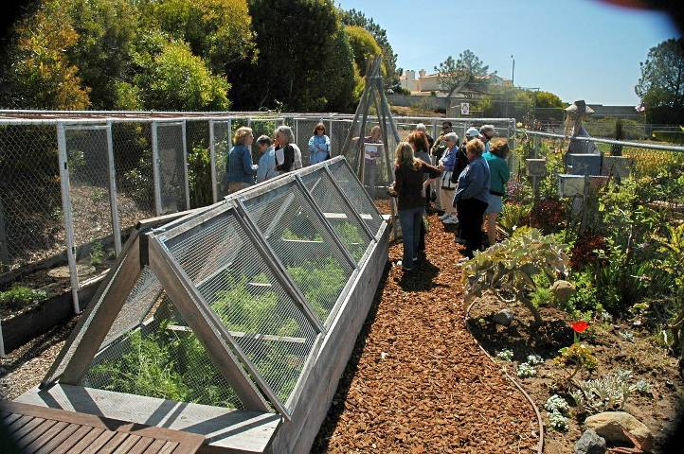
EXCLUSION

Slide 20
PEST MANAGEMENT INTEGRATED PEST MANAGEMENT (IPM)
An integrated program that relies on alternate techniques for pest control and prevention of garden problems.
IPM does not eliminate pests, instead it endeavors to keep them under control and reduce damage to a tolerable level.
Type in HTTP://IPM.UCDAVIS

