Slide 1
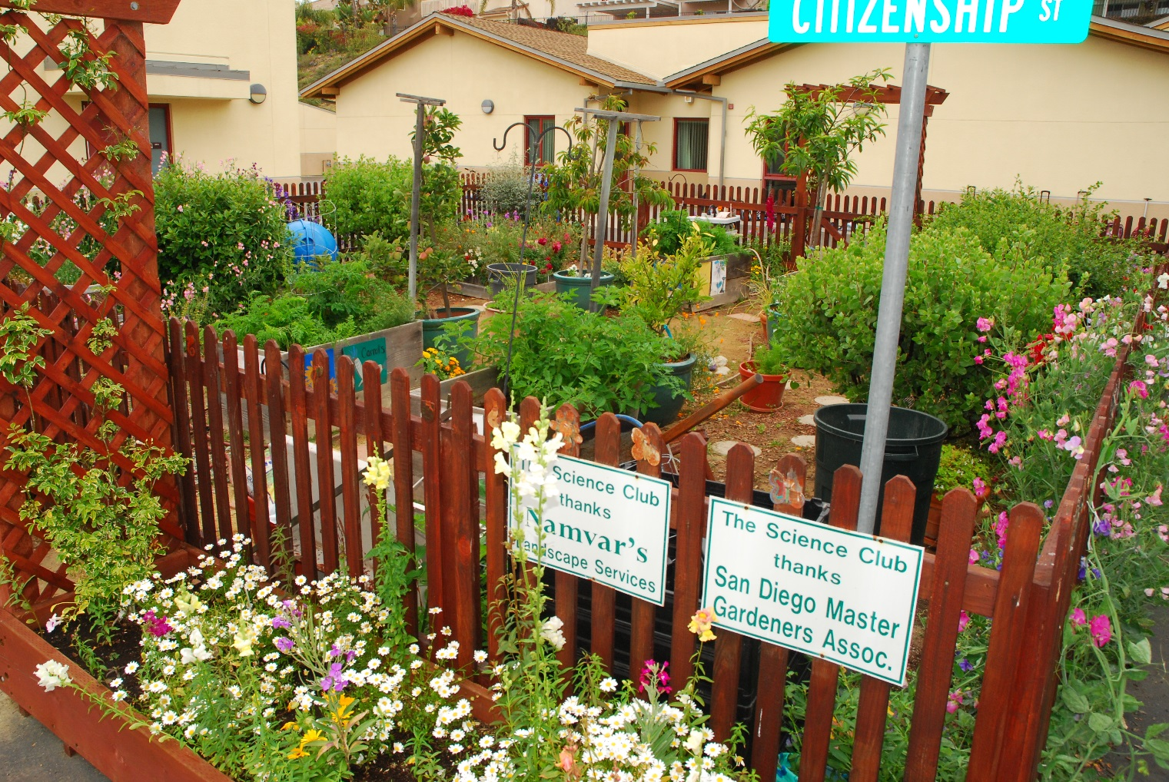
CREATING A SCHOOL GARDEN
Master Gardener Association/San Diego County
Notes:
‹#›

Slide 2
CREATING A SCHOOL GARDEN TOPICS
Site Selection and Design
Raised Beds
Drip Irrigation & Self Watering Planters
Planting the Garden

Slide 3
GARDENS CAN EXPAND STUDENT LEARNING
Instruction can fulfill Next Generation Science Standards (NGSS) and current common core
Hands on learning brings textbook learning to life
Outdoor lessons are an additional way to reinforce learning

Slide 4
SITE SELECTION AND DESIGN
Locate close to classrooms
Sun to shade exposure
Access to water source
Room for expansion

Slide 5
SIZE

Slide 6
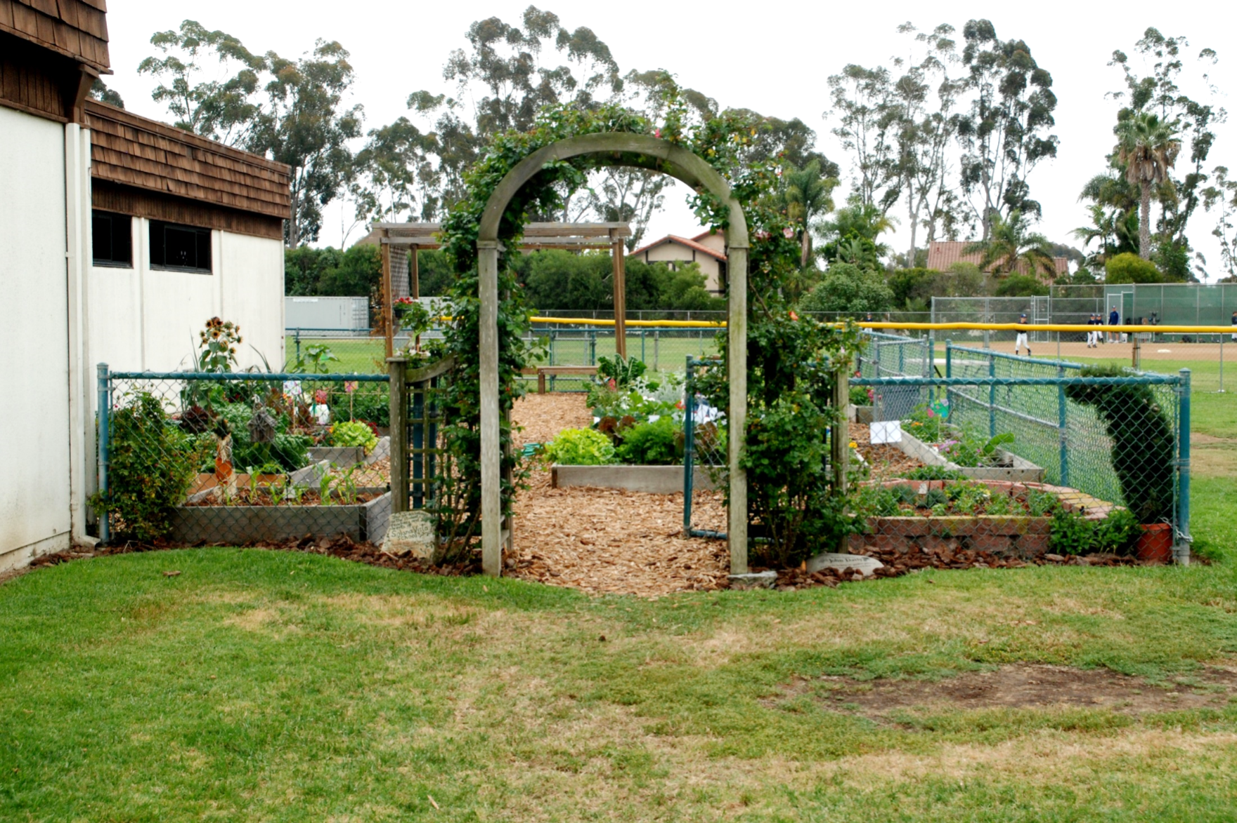
LOCATION AND ACCESSIBILITY

Slide 7
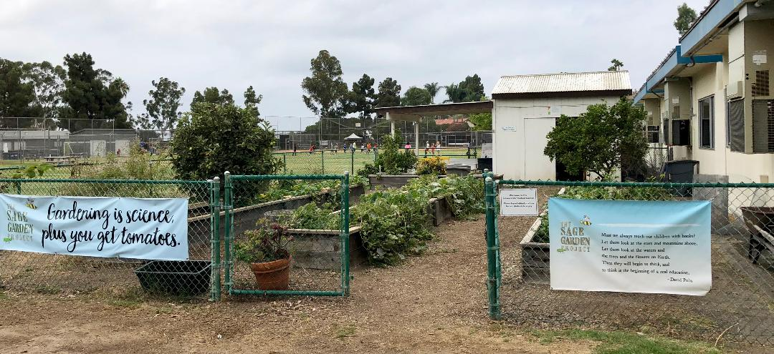
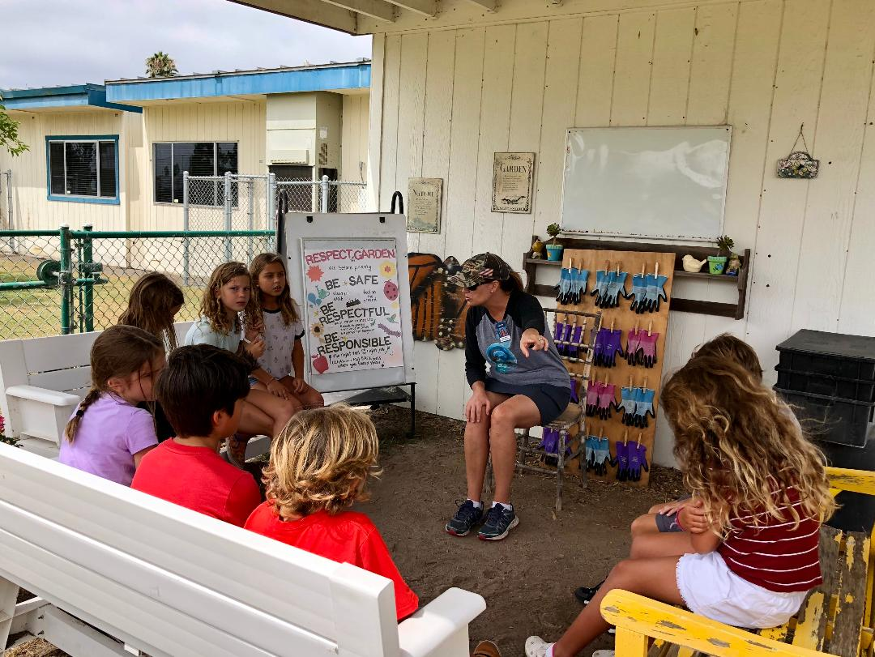

Slide 8
DESIGN FEATURES
Wide pathways for students
Potting tables
Tool sheds
Seating

Slide 9
SECURITY
Sunlight in the garden
Unwanted pets, balls, pranksters
Fencing provides security
Notes:
Involve students. They actually think of things that adults don’t. This and the following slide show examples of design and components you may want to include in your garden
‹#›

Slide 10
SUN EXPOSURE
6 hours sun - grow vegs. and flowers
Monitor site - seasons of the year
Shade patterns - trees, buildings

Slide 11
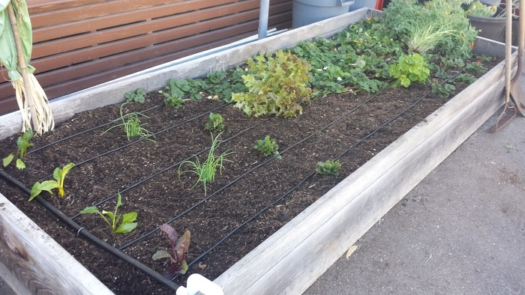
WATER SOURCES
Garden near water sources
No dragging of hoses
Cleaning hands and tools

Slide 12
Designing the
Garden
Make your plan on paper first
Planning - students, parents, teachers
Design - meet school expectations
Process - practical, functional and fun

Slide 13
DESIGN CONSIDERATIONS
3 different designs
Visit other school gardens
Take pictures of layouts
Check websites for design ideas and components to include in your garden
Student ownership of garden design
Design handout in your folders - more tips

Slide 14
