Slide 1
Lessons Learned
Establishing and Maintaining Community Gardens
Amy Zink
Horticultural Therapist, Garden Educator, Urban Farmer
Associate Director- Bayside Environmental Learning Center (BELC)
Bayside Community Center
azink@baysidecc.org
Notes:
30 sec
Introduce speakers

Slide 2
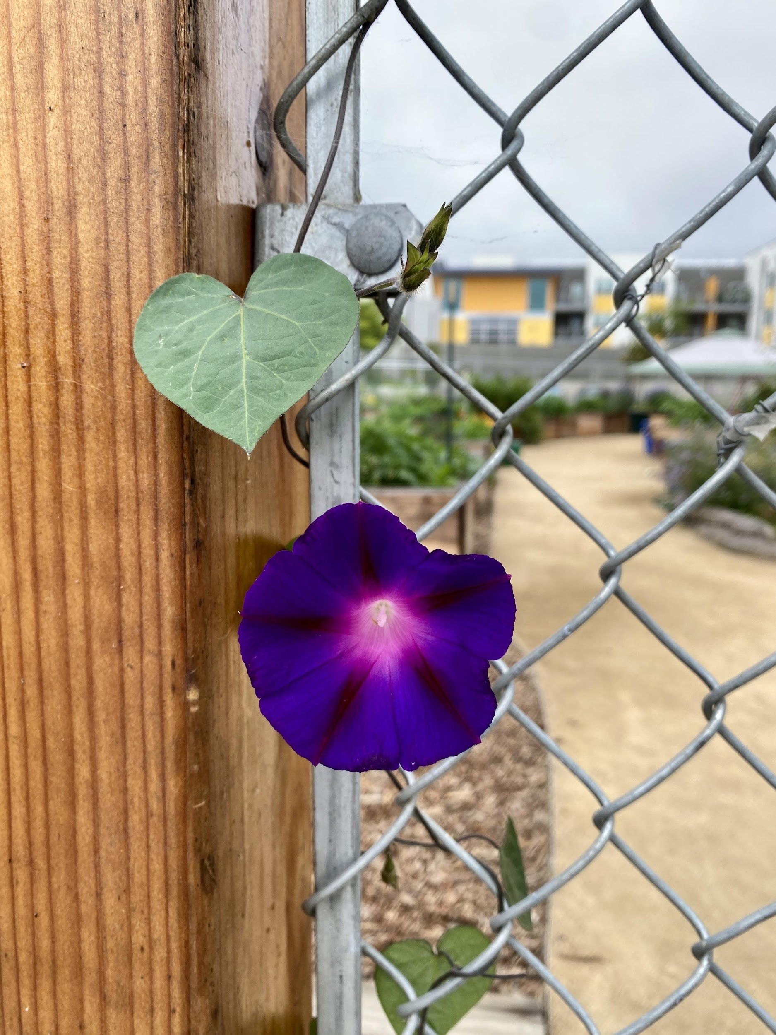
Lessons Learned
1. Brief Overview of Bayside Community Center
2. Bayside’s Environmental Learning Center Programs
3. Bayside’s Gardens
4. Linda Vista Community Garden
5. Community Garden Workshop Series
6. Community Engagement
7. Garden Organization & Management
8. Communication
9. Volunteers
10. Issues and Ongoing Challenges
11. Questions /Open discussion
Notes:
30 sec
Read outline of presentation Kim Hanson

Slide 3
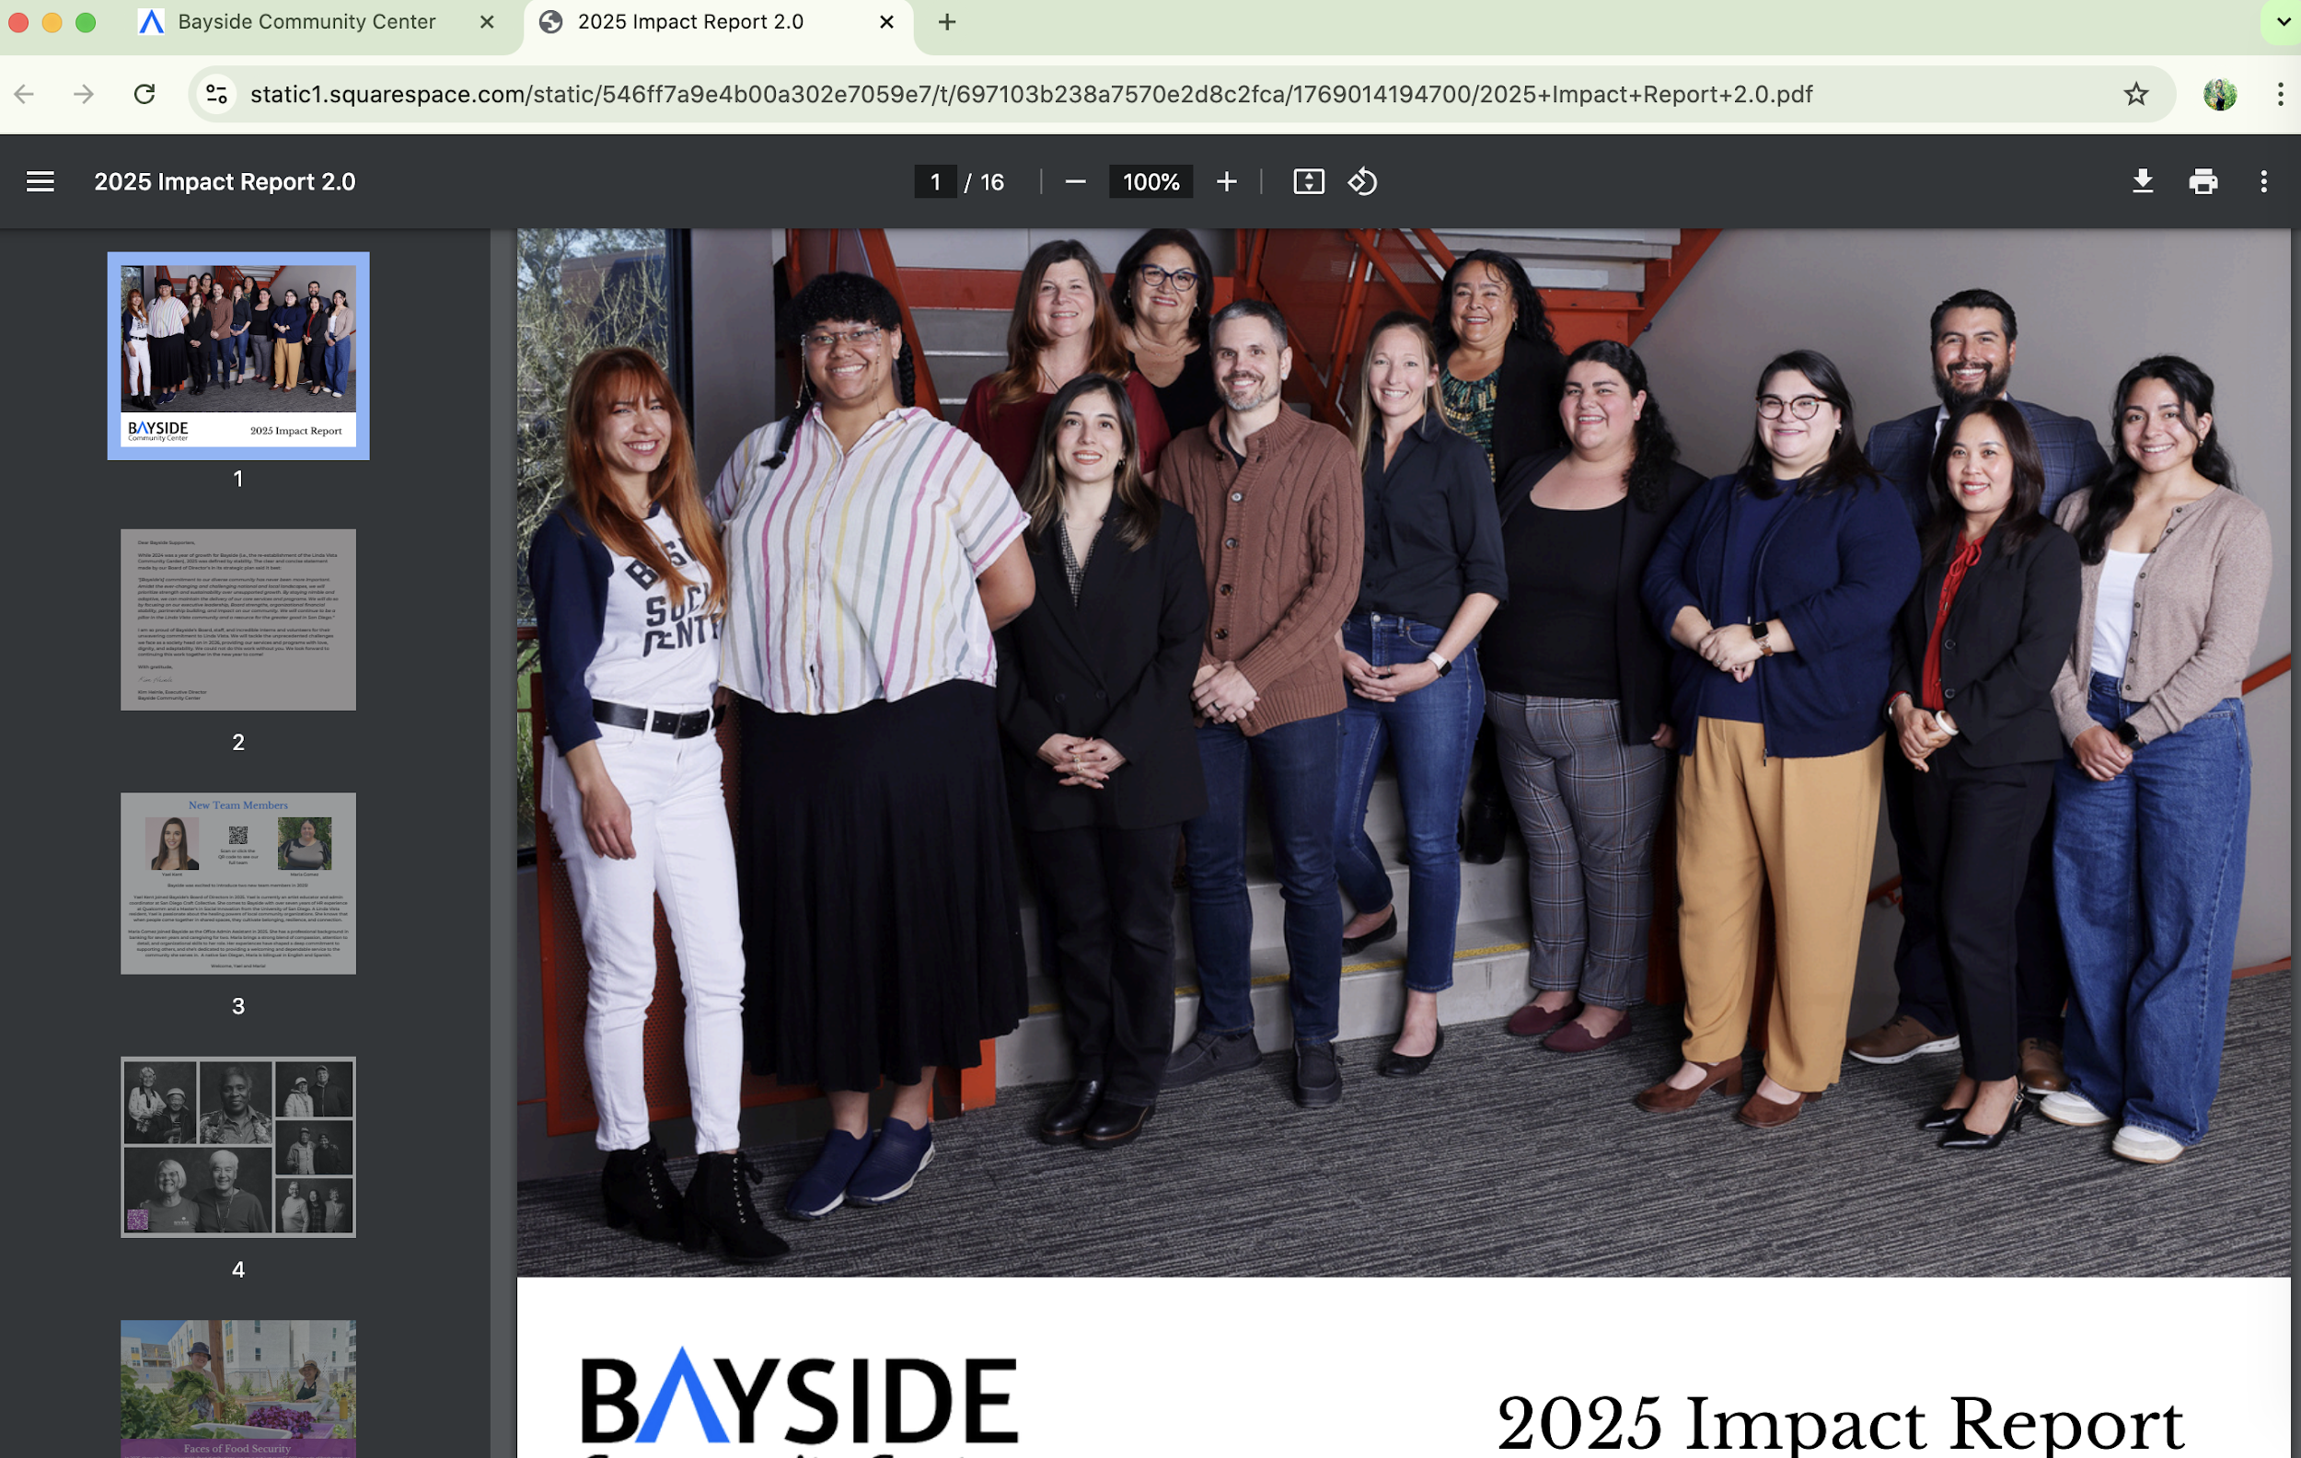
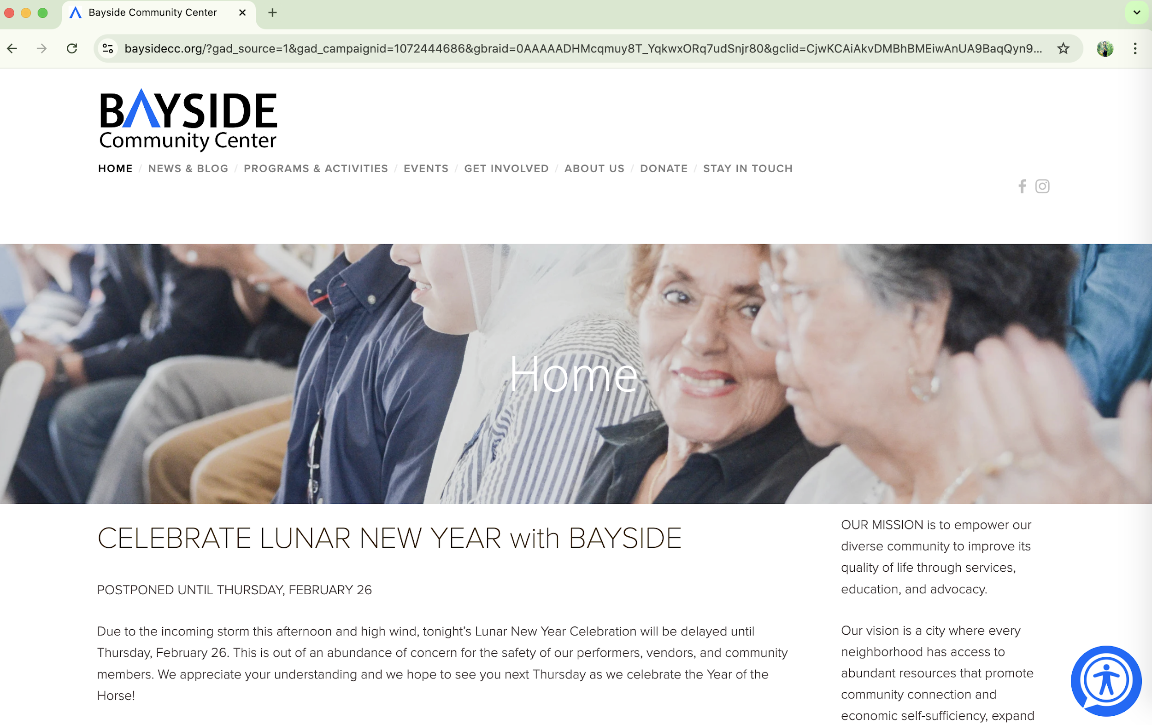
Bayside Community Center
What is Bayside ?
Bayside is an independent 94 year old, non-profit, neighborhood-based organization that serves the whole person and community. Located at 2202 Comstock Street in the heart of Linda Vista, our facility is visited daily by many San Diegans. Social services, educational opportunities and advocacy efforts all exist under one roof, through which we encourage and empower members of the community to create abundant lives.
2025 Impact Report
www.baysidecc.org
Notes:
3 min
Bayside Community Center has programs through out Linda Vista
Our Mission:
Can be found on our website (click) & read mission
To see what we have accomplished in 2023, follow the link to our 2023 Impact report
(click highlight report link), (click arrow shows front page of report)
Live link on slide: baysidecc.org
>>A more in depth presentation about Bayside will happen later in the year.
>>Today we want to focus on Bayside’s Environmental Learning Center & the Linda Vista Community Garden

Slide 4
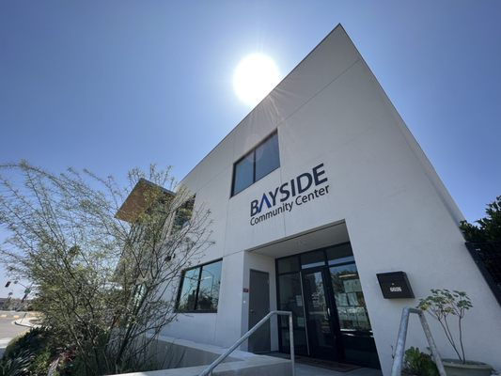
Bayside
Community
Center
2202 Comstock Street
San Diego, CA 92111
Telephone: 858.278.0771
Email: baysideinfo@baysidecc.org
Notes:
30 sec
Who doesn't know where Bayside is located ?
Here is our front door.
On the Comstock side of the building we share with theCounty Office of Ed's Innovation center.
Fire department across the street.
Skateworld is catty-corner

Slide 5
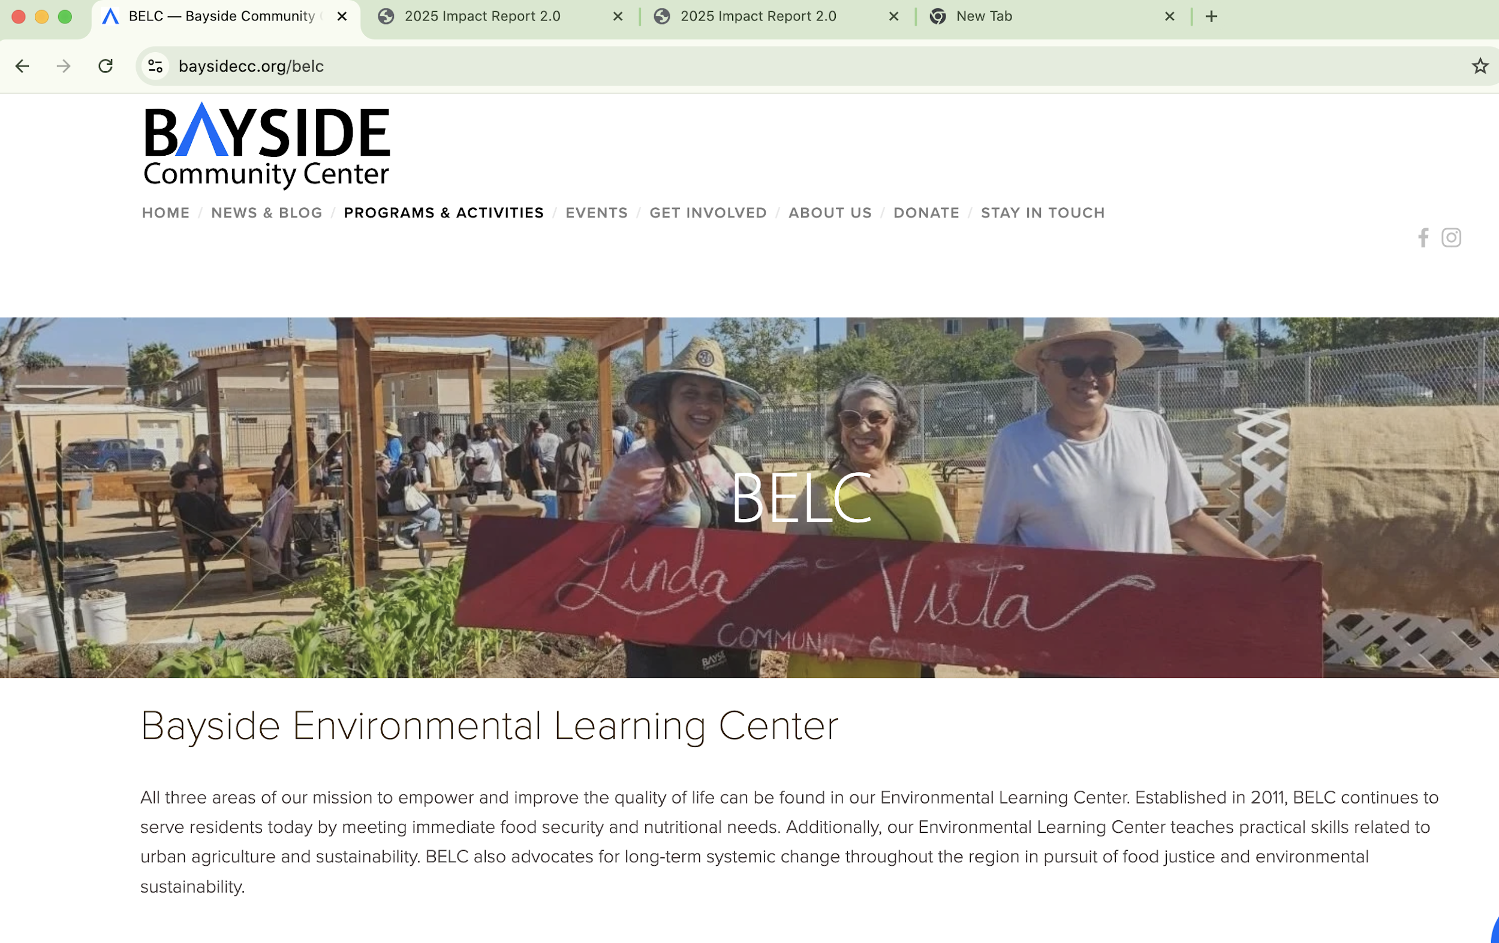
Bayside’s Environmental Learning Center (BELC)
Programs
Food Production & Recovery
Tiny Gardens
Garden Therapy Field Trips
Seed Library
Seed Starting Class
Seed Starting Consultations
  @ LV Farmers’ Market
Co-Op Gardening
Community Gardening
  Classes, Volunteer Events, Senior Cooperative gardening & more
https://www.baysidecc.org/belc
Notes:
3 min
This program supports all 3 pillars of our mission Services Education & Advocacy
-Meets critical needs
-Teaches long term skills
-And advocates for change at systemic levels
SERVICE & Advocacy
Our Environmental Learning Center is also a hub that empowers others to produce and recover fresh produce.
Partners like San Diego Co-Harvest, Produce Good, Mesa College, Francis Parker,
individual farmers and gardeners throughout the county to make free and fresh food available in Linda Vista.
Education & Advocacy
Variety of Educational opportunities (read off list, brief 2-3 word descriptions)
Free Seed opportunities (see asterisks)
>>We have some photos to share

Slide 6
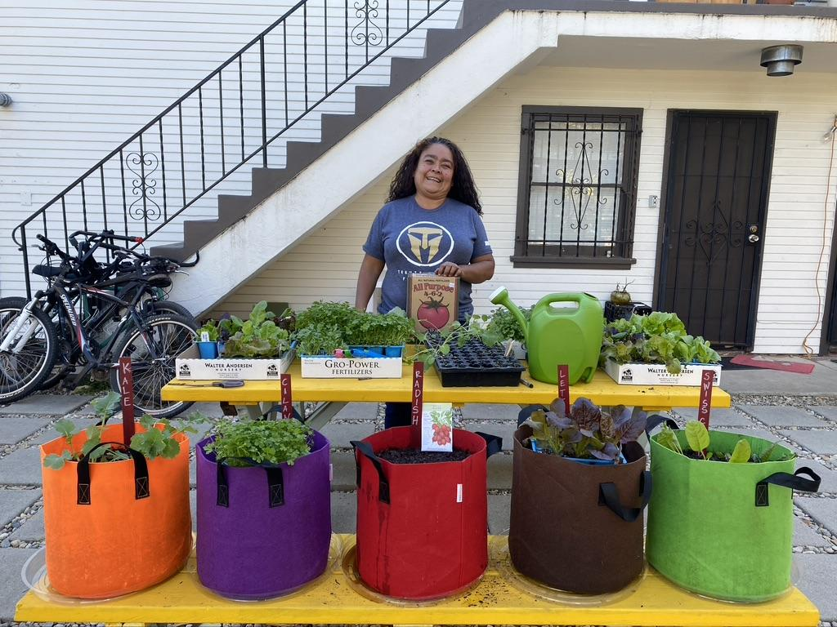
Bayside Tiny Garden Project
Launched in 2020- Completed 4th Cohorts
6 – 10 Families receive portable grow bags + monthly education
Low income families increase fresh produce and learn how to supplement their food budget growing seasonal produce
Program Runs January - October
Notes:
1 min
Read slide

Slide 7
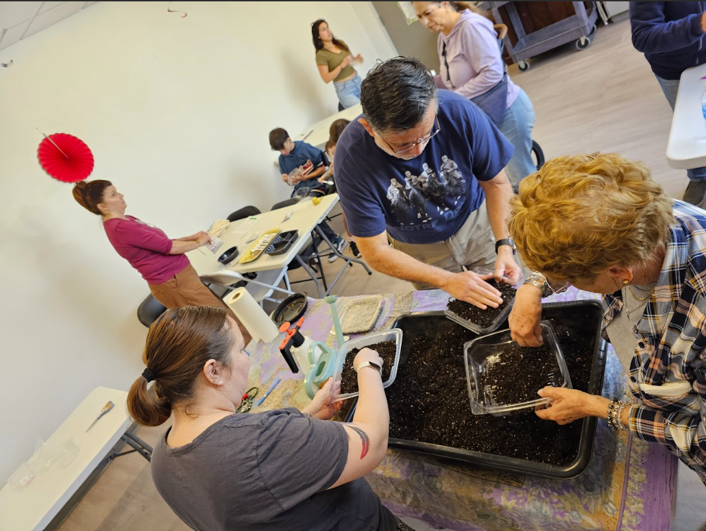
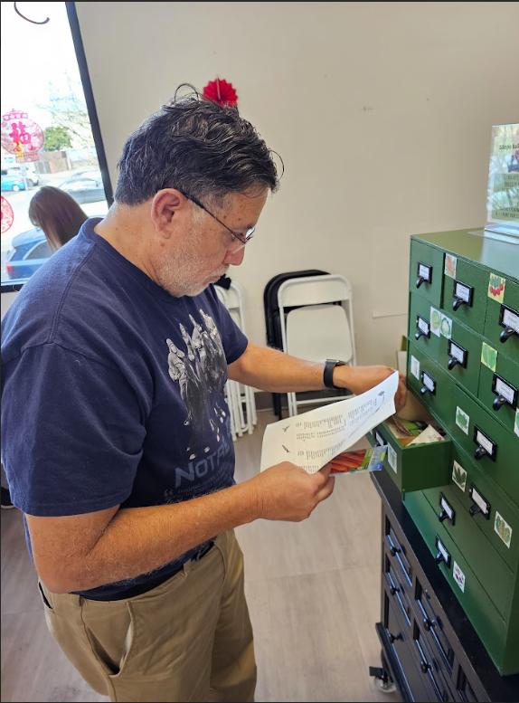
Seed Starting Class
3rd Friday of Month @ Bayside 12:30-1:30 PM
Notes:
Master Gardener Grant supported the creation of our Seed Library
Seed starting Class every 3rd Friday of the month in Bayside’s community room
Project to take home.
Seed Library: Check out 3 seed packets every month – Free seeds

Slide 8
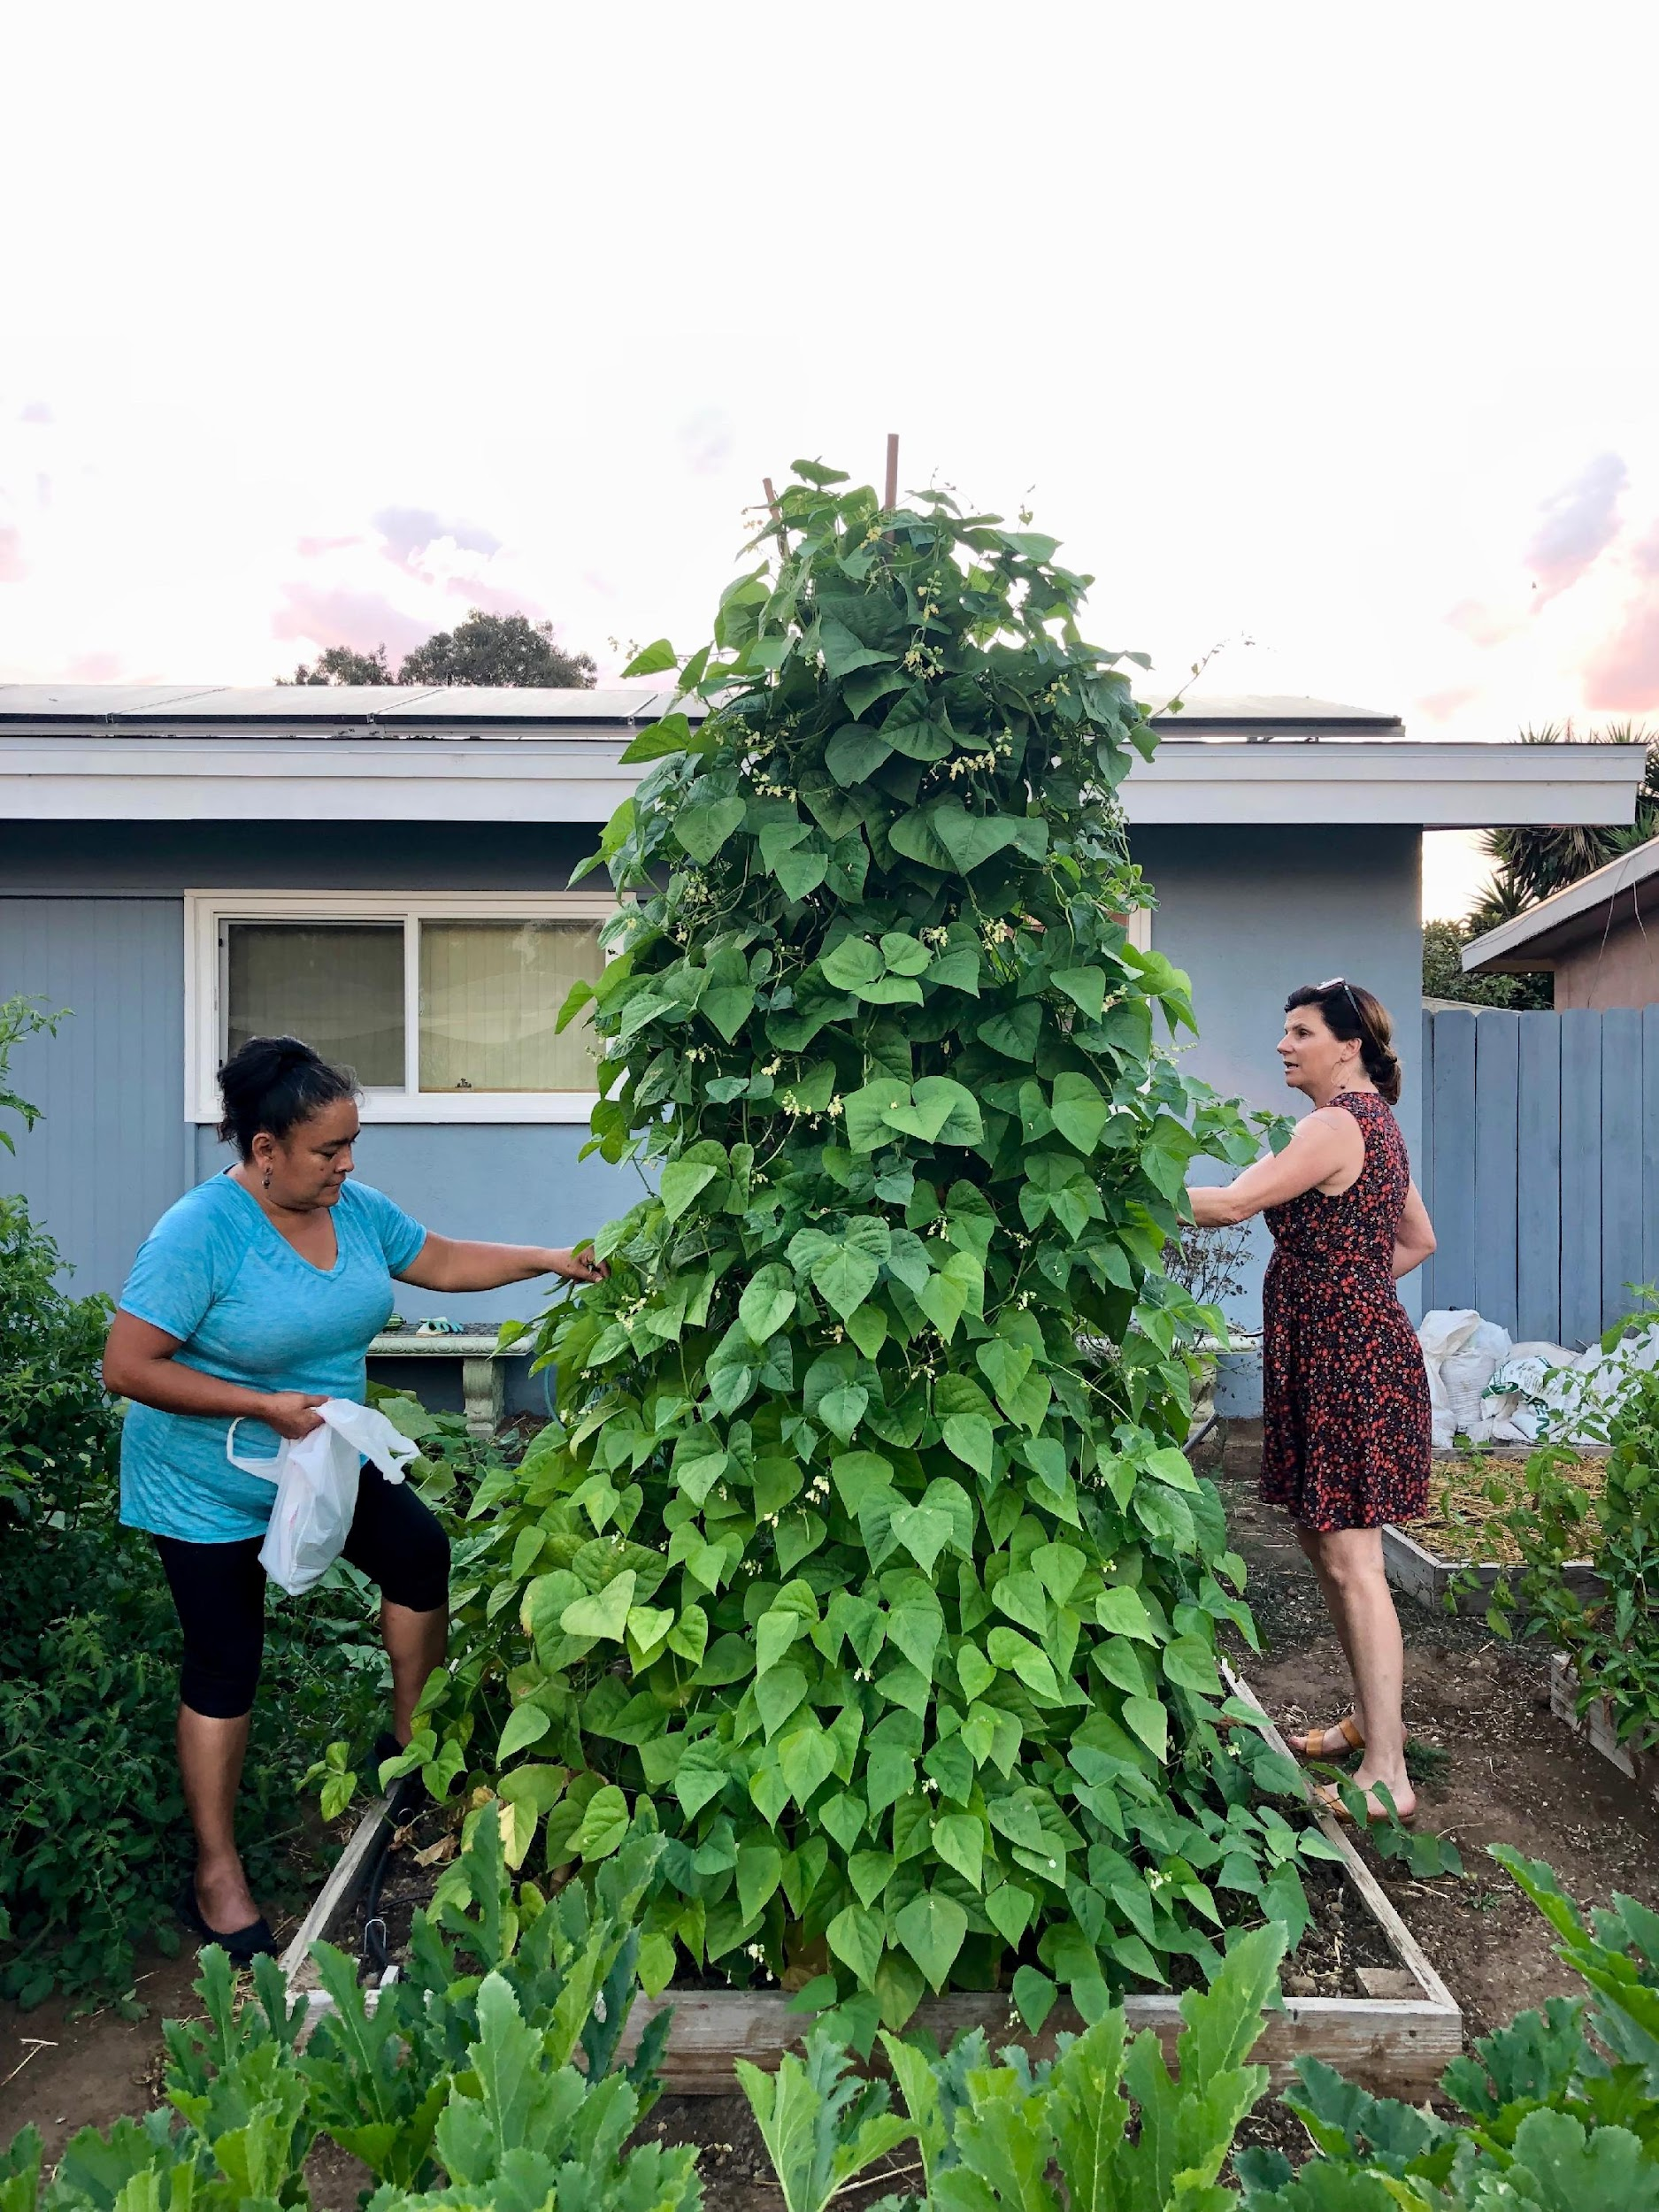
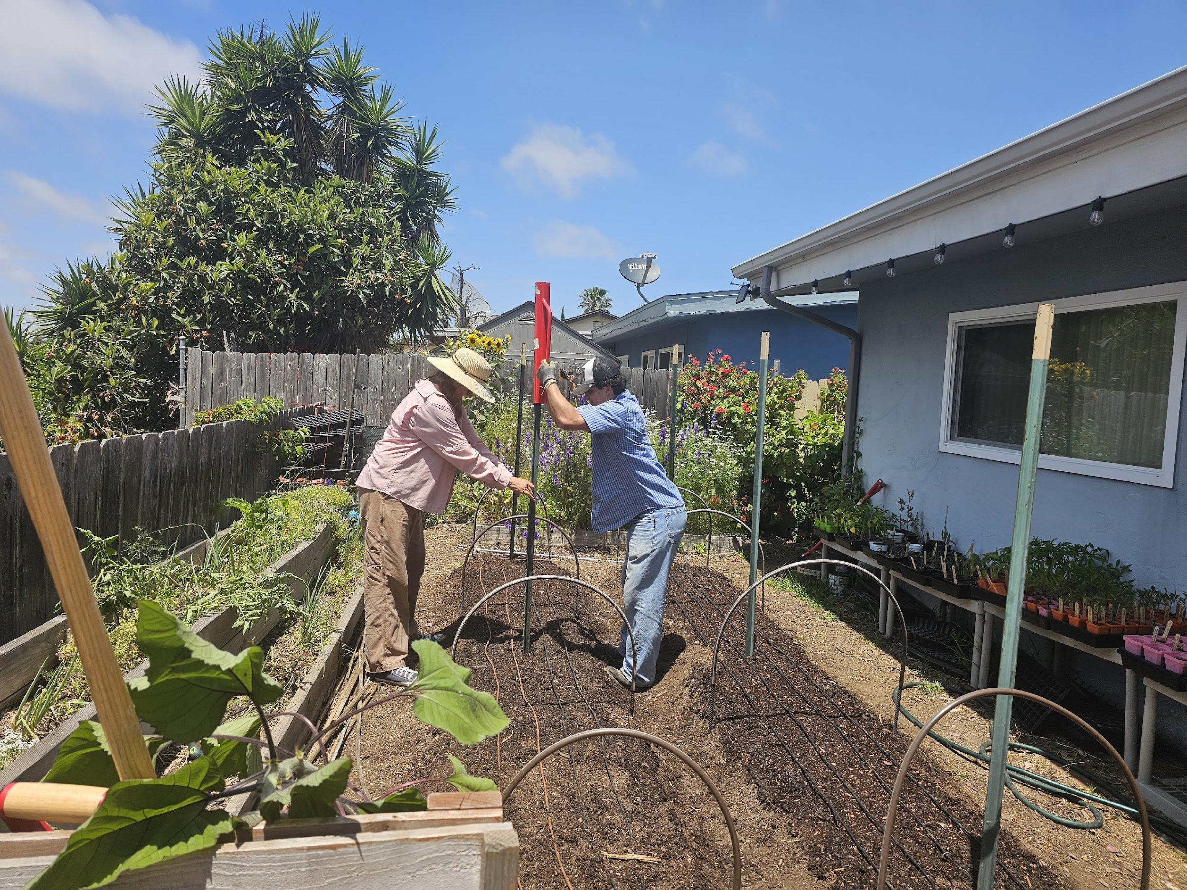
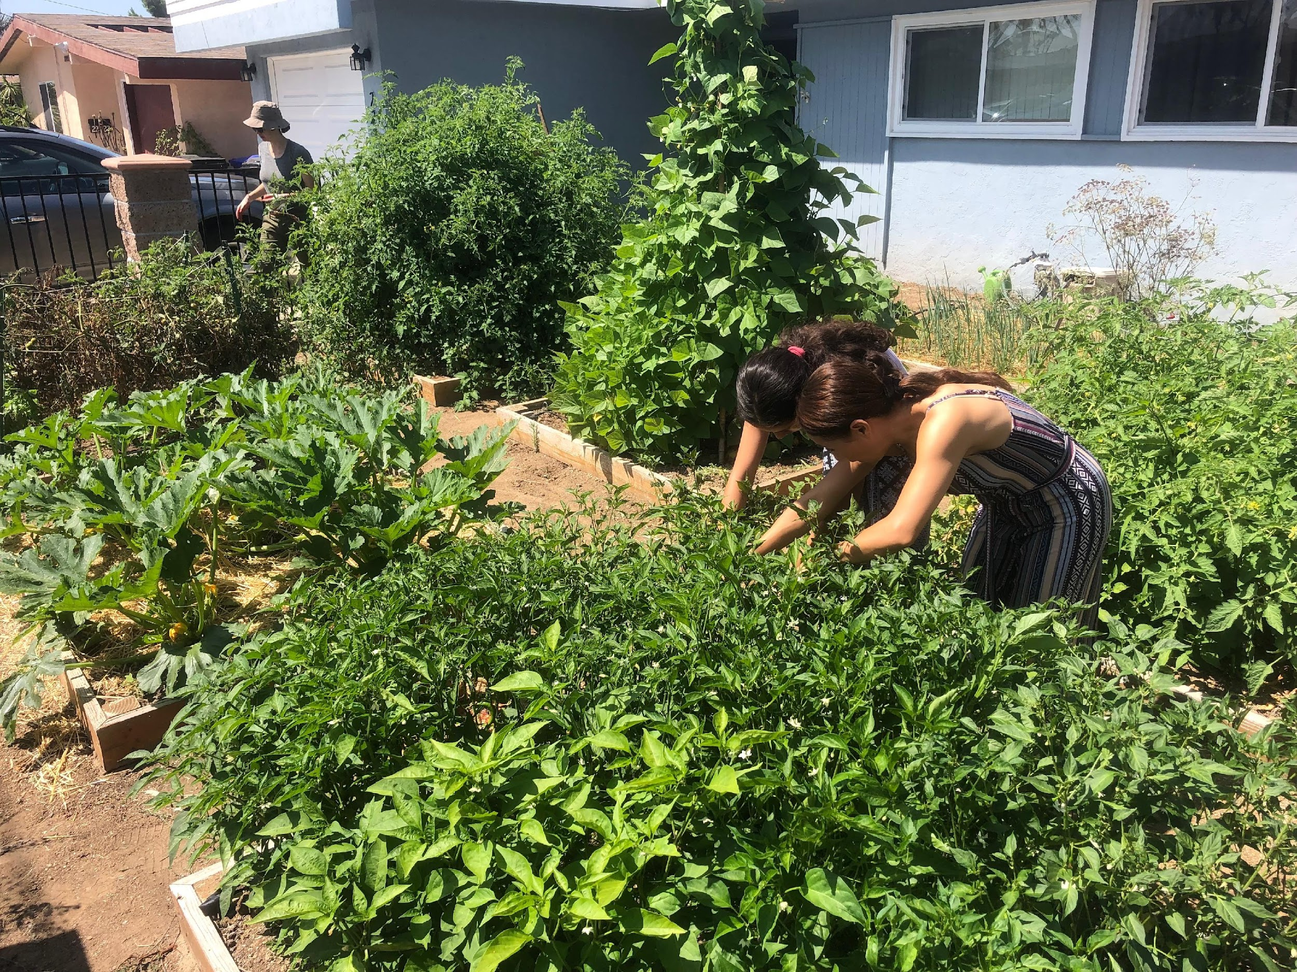
Co-Op Gardening
Notes:
Programs here – College Core Fellows – TMI Seed Starting – Supported Work Program
CoOp gardening at Bayside’s CoOp garden.
Cooperative relationship with an anonymous donor who owns the home –
Relationship includes – owner offers below market rent to single mom and daughter in exchange to use for food production and programming.
Garden in maintained by volunteers.
Production garden to supply Bayside’s weekly food distribution.

Slide 9
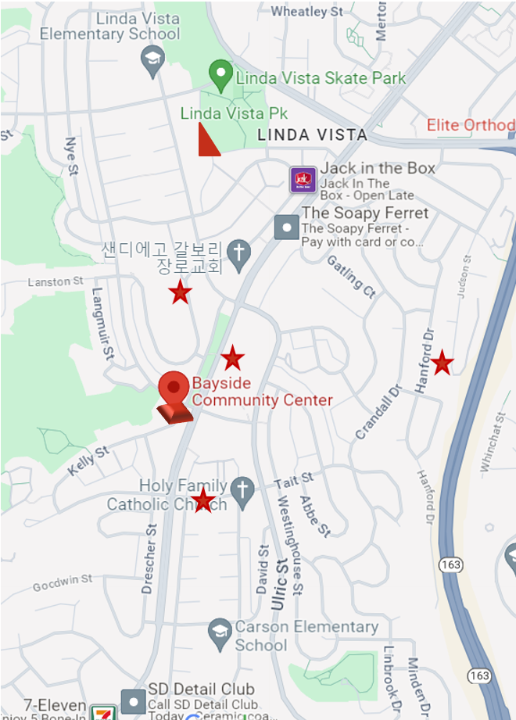
Bayside’s Environmental Learning Center
Gardens
Co-Op Garden
Advancing Students Forward (ASF) Garden
Linda Vista Community Garden
Local School Garden Engagement
  Montgomery Middle School Garden
  High Tech High Mesa
  Carson Elementary
  Linda Vista Elementary
  San Diego Cooperative Charter School
Notes:
1 min
Read list
Now turning our focus to the Linda Vista Community Garden
Q: How long do you think we have been growing food in LV?

Slide 10
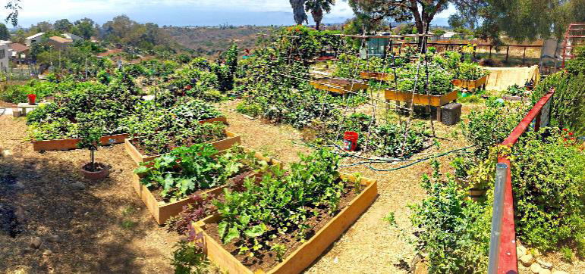
History
Linda Vista Community Garden at Bayside
Established Spring 2011
Uprooted Spring 2017
Notes:
Story of Garden – then accessing land
Bayside did have a Community Garden
Uprooted due to Redevelopment of the Property
Since 2017 we’ve been looking for a new home
Officially applied with the City in January of 2020 for new location

Slide 11
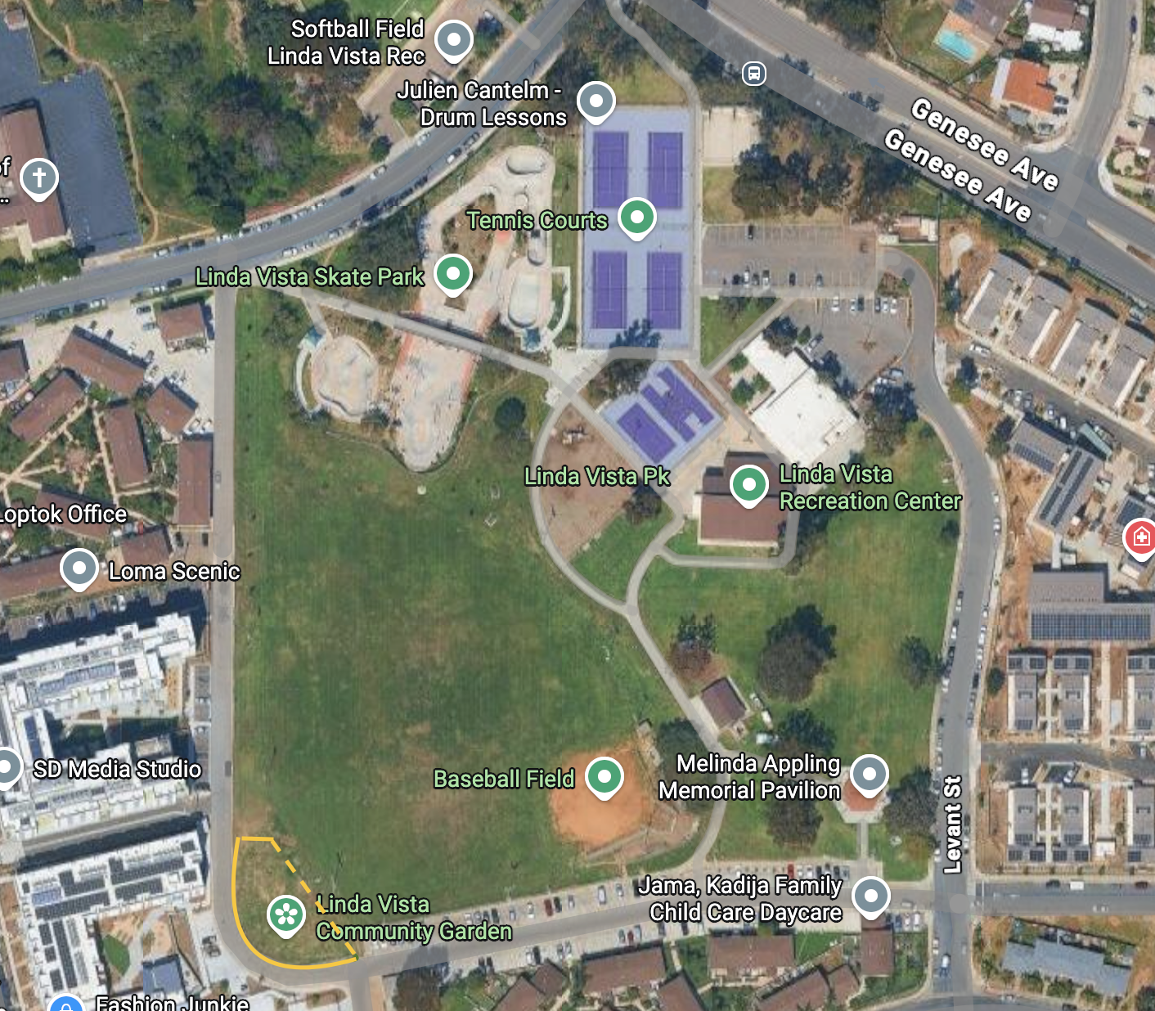
Garden Site Location
Linda Vista Community Park
Notes:
Affordable housing nearby – lots of land – first of its kind
New location in Linda Vista Community Park
Officially applied with the City in January of 2020

Slide 12
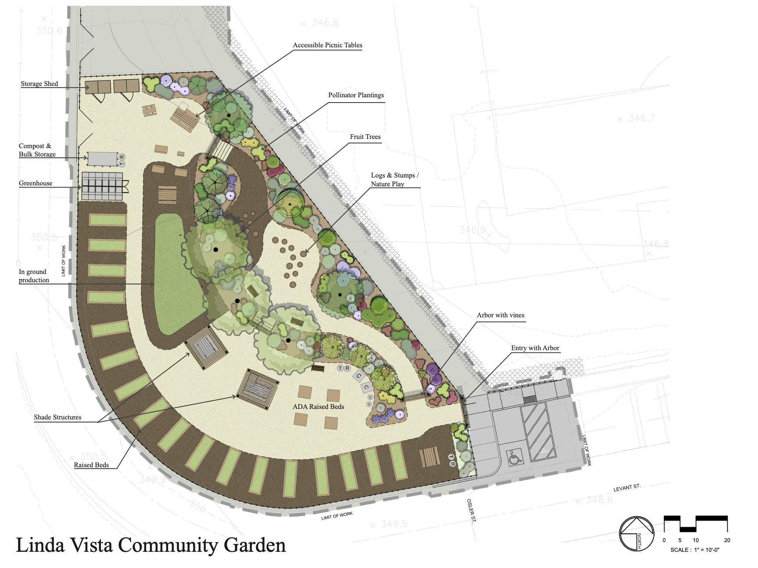
Garden Design
Garden Features
21 Garden beds for Linda Vista Community Members
  17 Individual Rental
  4 Cooperative for Older Adults
Bayside Production Garden
Shaded Gathering Area
Fruit Trees
Pollinator and Native garden
Compost
Greenhouse
Outdoor Classroom
Notes:
Square footage 10,500 sq ft – something for everyone
Go over amenities as listed on slide.

Slide 13
Approval Process
Spring 2017 Bayside meeting and introduction to Park Designer Shamili Tarbell, Debbie Marcotte & Casey Smith through USD Professor
July 2019 Park Visit – Potential Site Location Identified
January 2020 - Submitted Proposal for City Attorney to review identified Location for any potential liabilities.
June 2020 - City Attorney approved proposal and signed off no liabilities with site
October 2020 – Community Garden Application Submitted
July 2020 - - Site Review location meeting with ADA & Park Designer, measurements, site photos and map created
January 2021 - Linda Vista Community Recreation Group Approval with Early Design Concept
February 2021 – Presented project to Council Member Raul Campillo and staff for support, Carpenters Union Connection
June 2021 – Hired Landscape Architect and Civil Engineer + Created LV Grows Steering Committee
February 2022 – Linda Vista Community Recreation Group Approval to amend the Linda Vista Community Park General Development Plan to include the Community Garden
March 2022 -NORA/CEQA Determination complete
April 2022 – City of San Diego Parks & Recreation Board Approval to amend the Linda Vista Community Park General Development Plan to include the Community Garden

Slide 14
Approval Process
June 2022 – Partnered with The San Diego Parks Foundation to fundraise and promote the project.
July 2022 – August 2022 – Finalized Design, Construction Documents and City Planning approval
September 2022 – Began search for General Contractor to take on the project and start bid requests from Landscape contractors
August 2022 – Started Garden gatherings in Linda Vista to recruit gardeners and volunteers + additional outreach
December 2023 – Ground breaking Ceremony
January – February 2024 – Secured General Contractor – choose Landscape Contractor - completed Right Of Entry permit
March 2024 – Construction started
May 2024 – Community Workdays each Saturday
June 2024 – Ribbon Cutting Ceremony
August 2024 – Official Special Use Permit signed – Gardeners planted first crops
Fall 2024- Summer 2025 - Growing Green Spaces Grant – Created and completed first Cohort – Community Garden Workshop Series.
Summer 2025 – Summer 2026 – Growing Green Spaces second year – Second Cohort Community Workshop Series
Ongoing 2026 – Working with Parks and Recreation to consult on the process and how best to improve it as related to the City’s Departmental Instruction for Community Gardens.

Slide 15
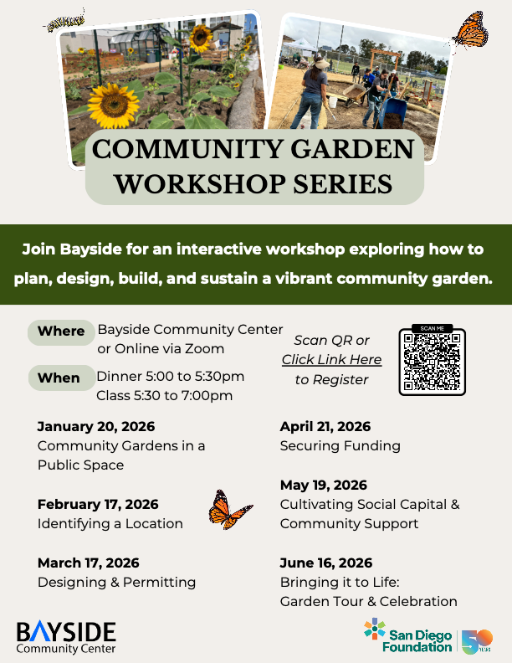
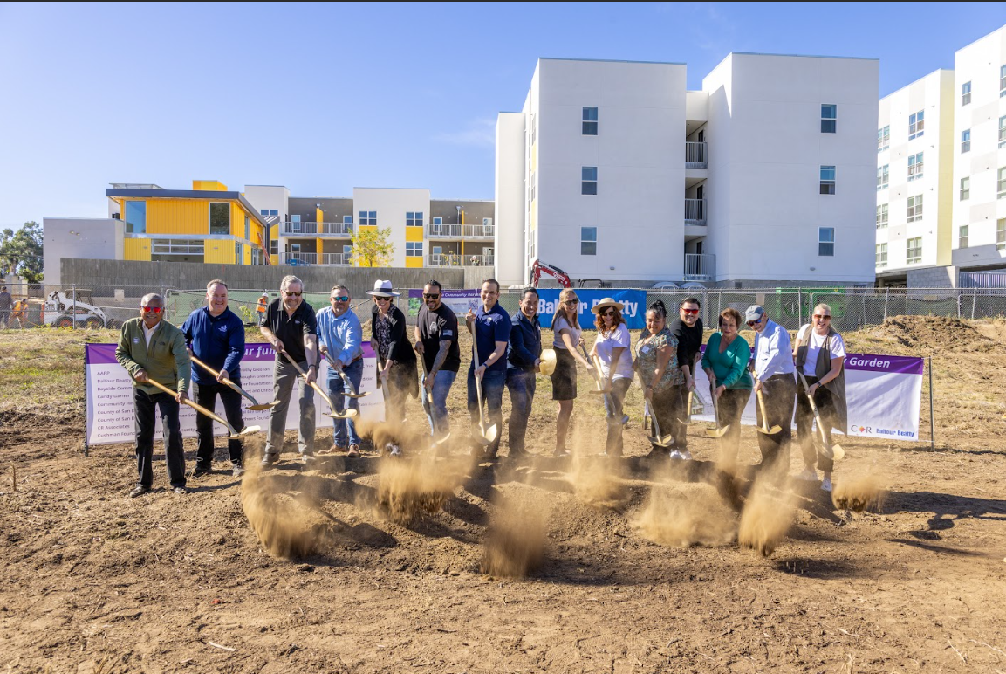
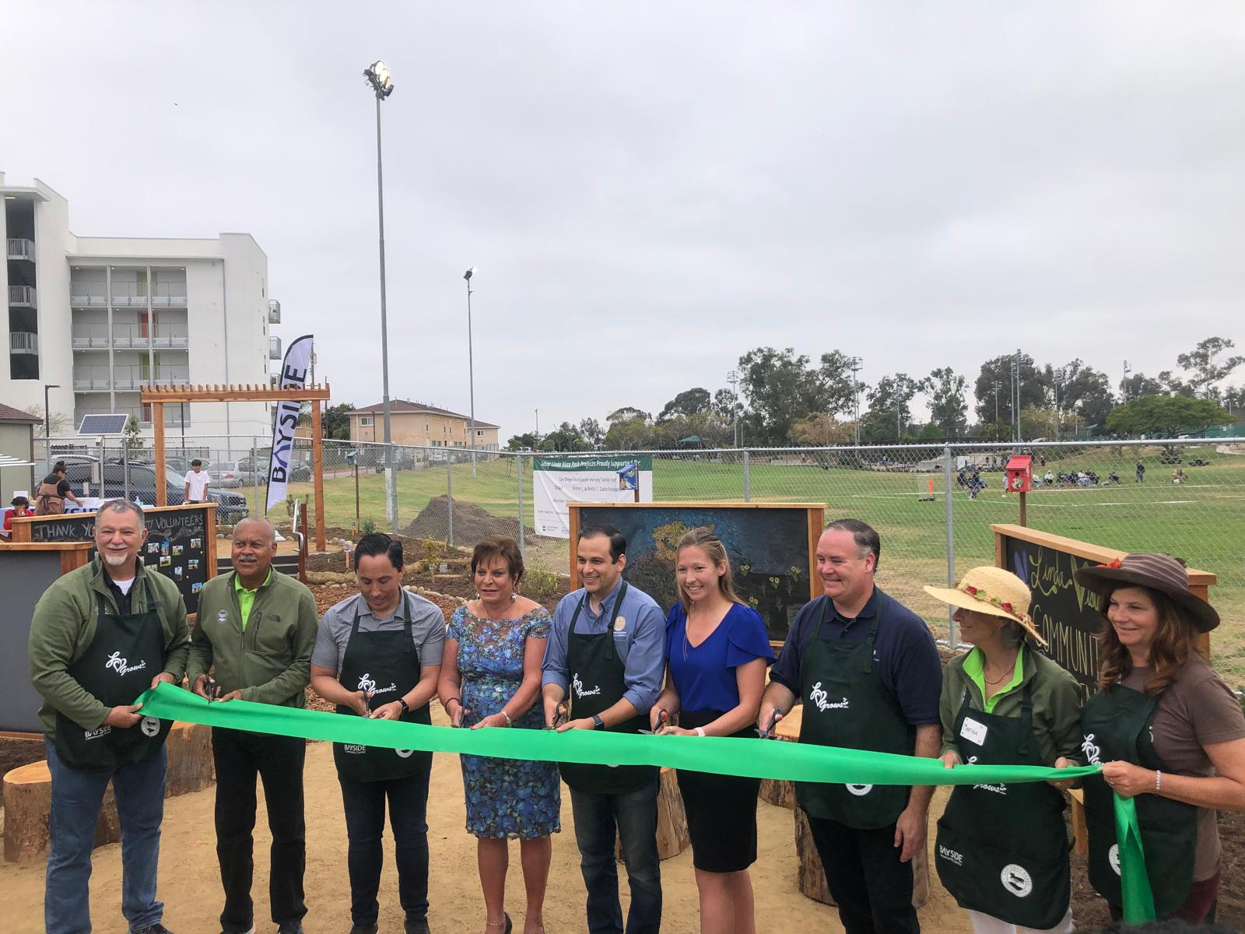
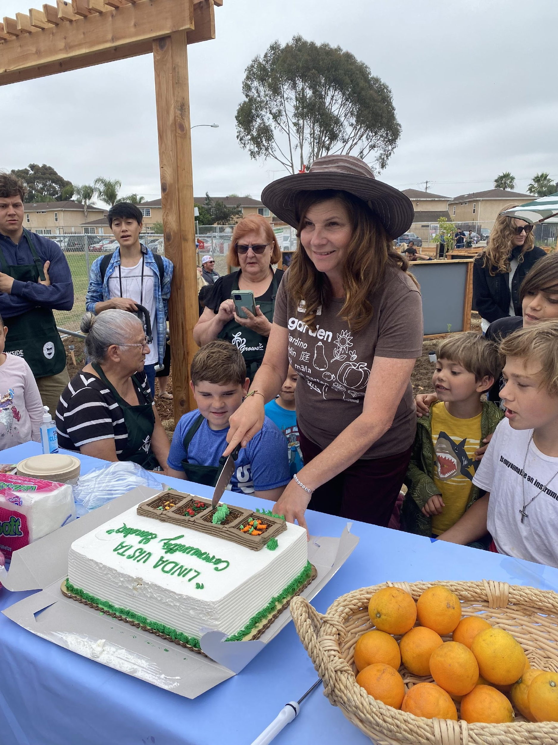
Notes:
We are also completed a guide book that accompany’s this class that will live on our website – soon to lauch

Slide 16
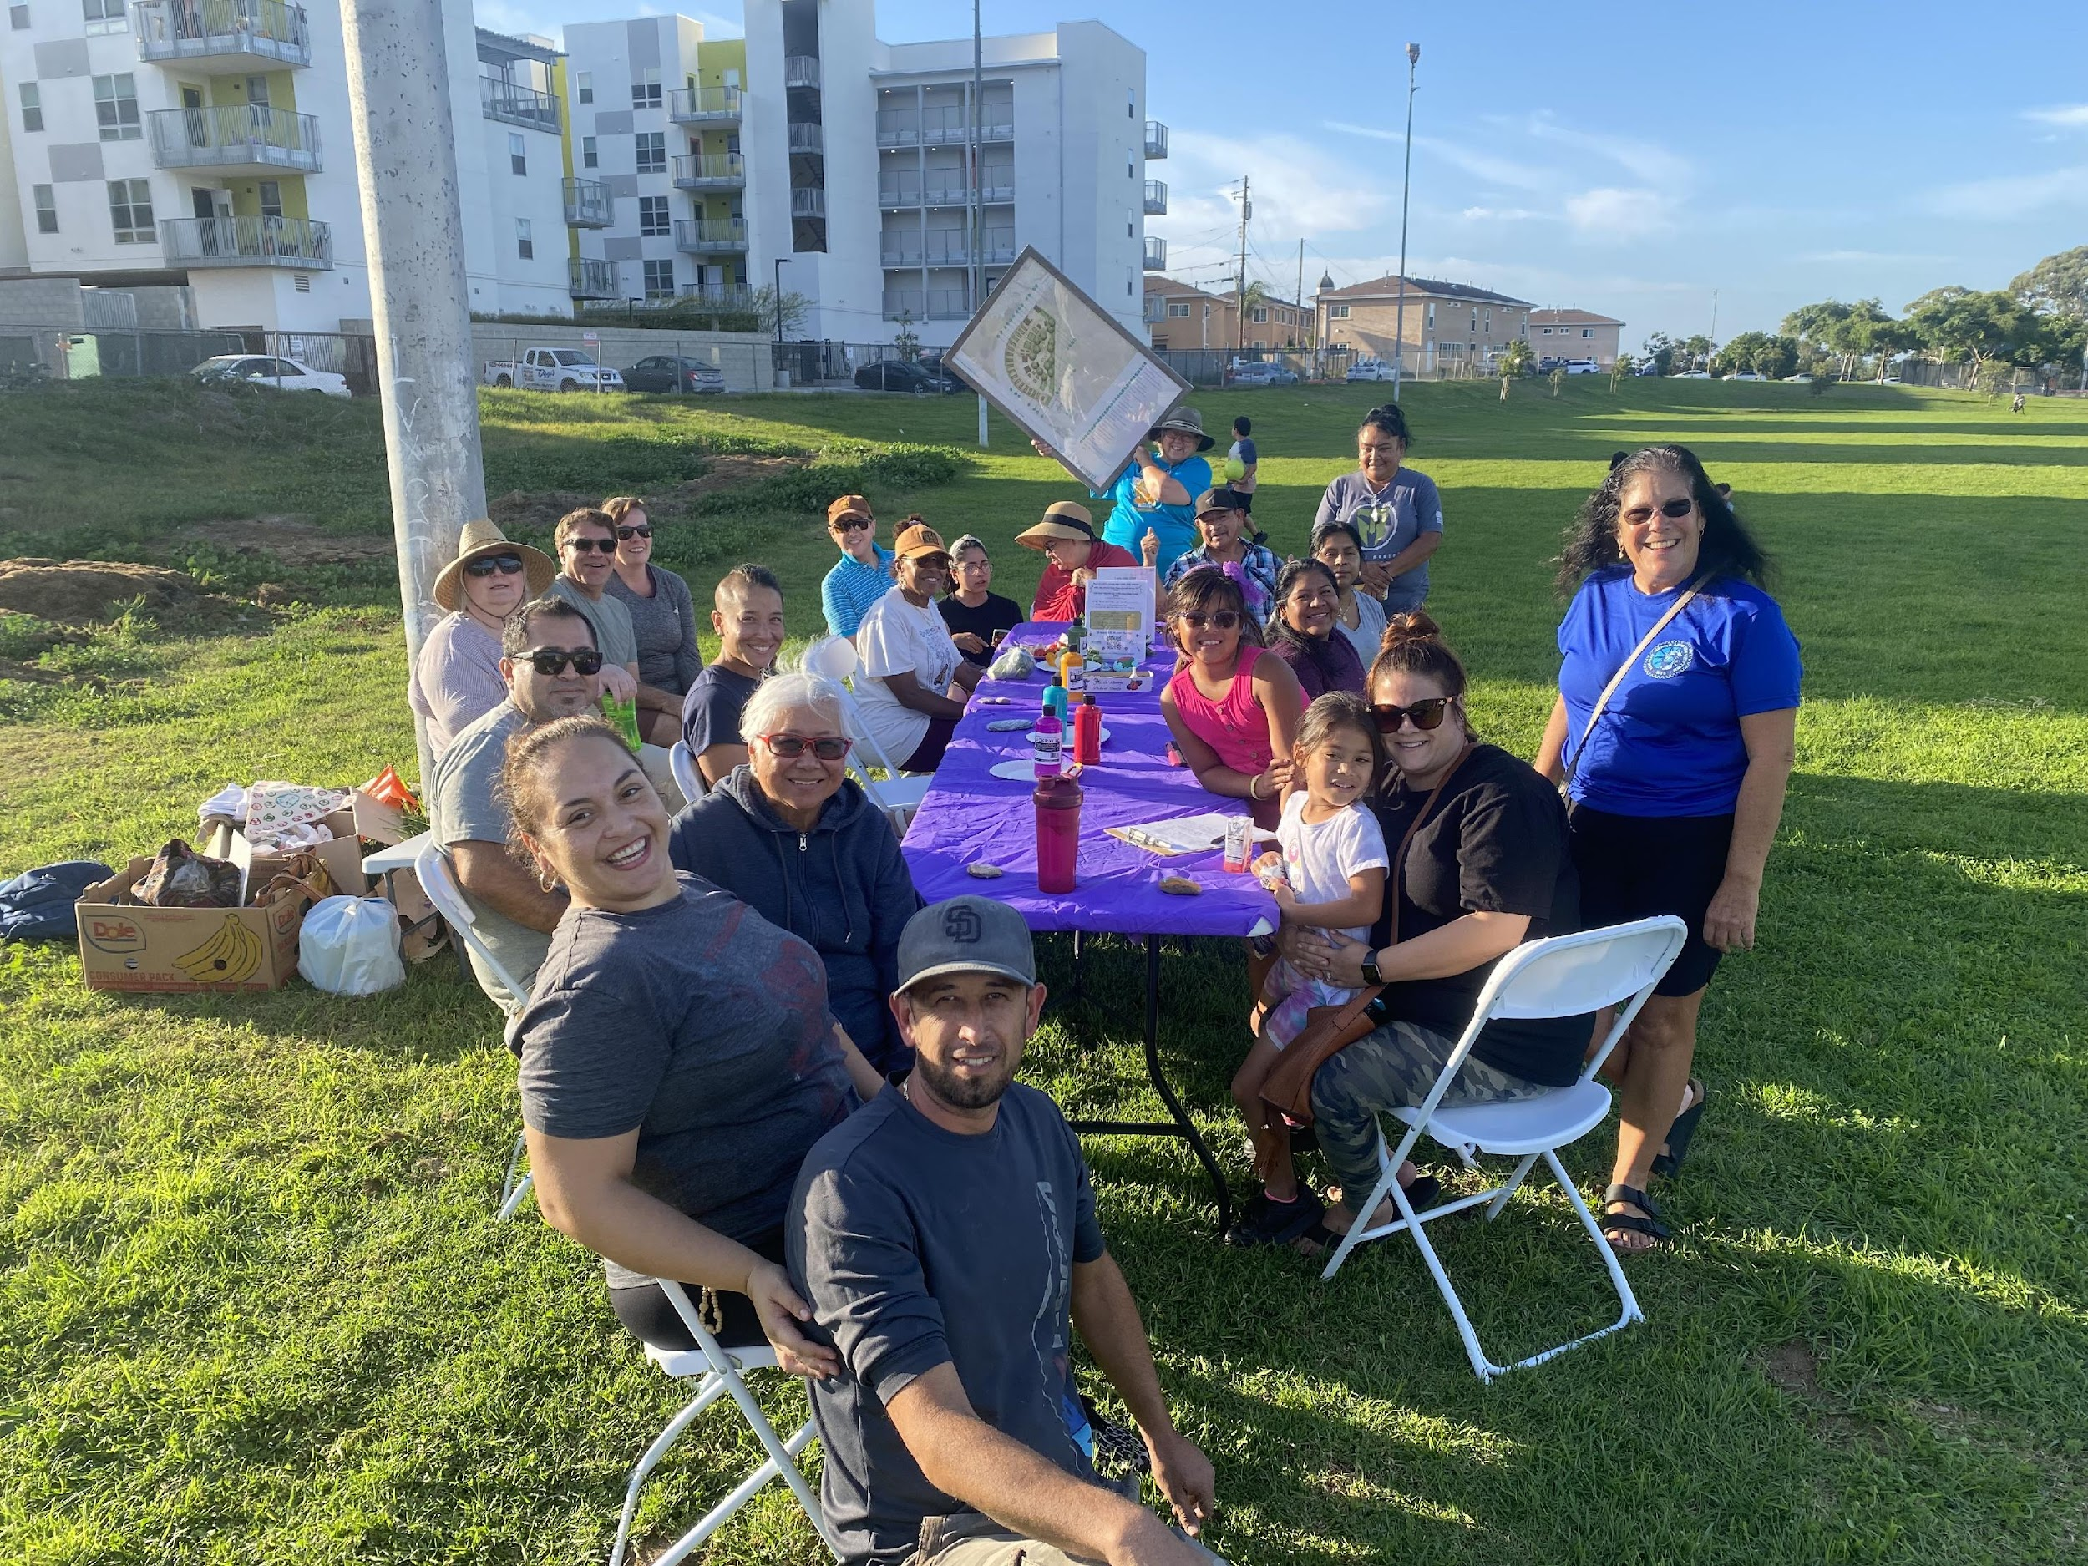
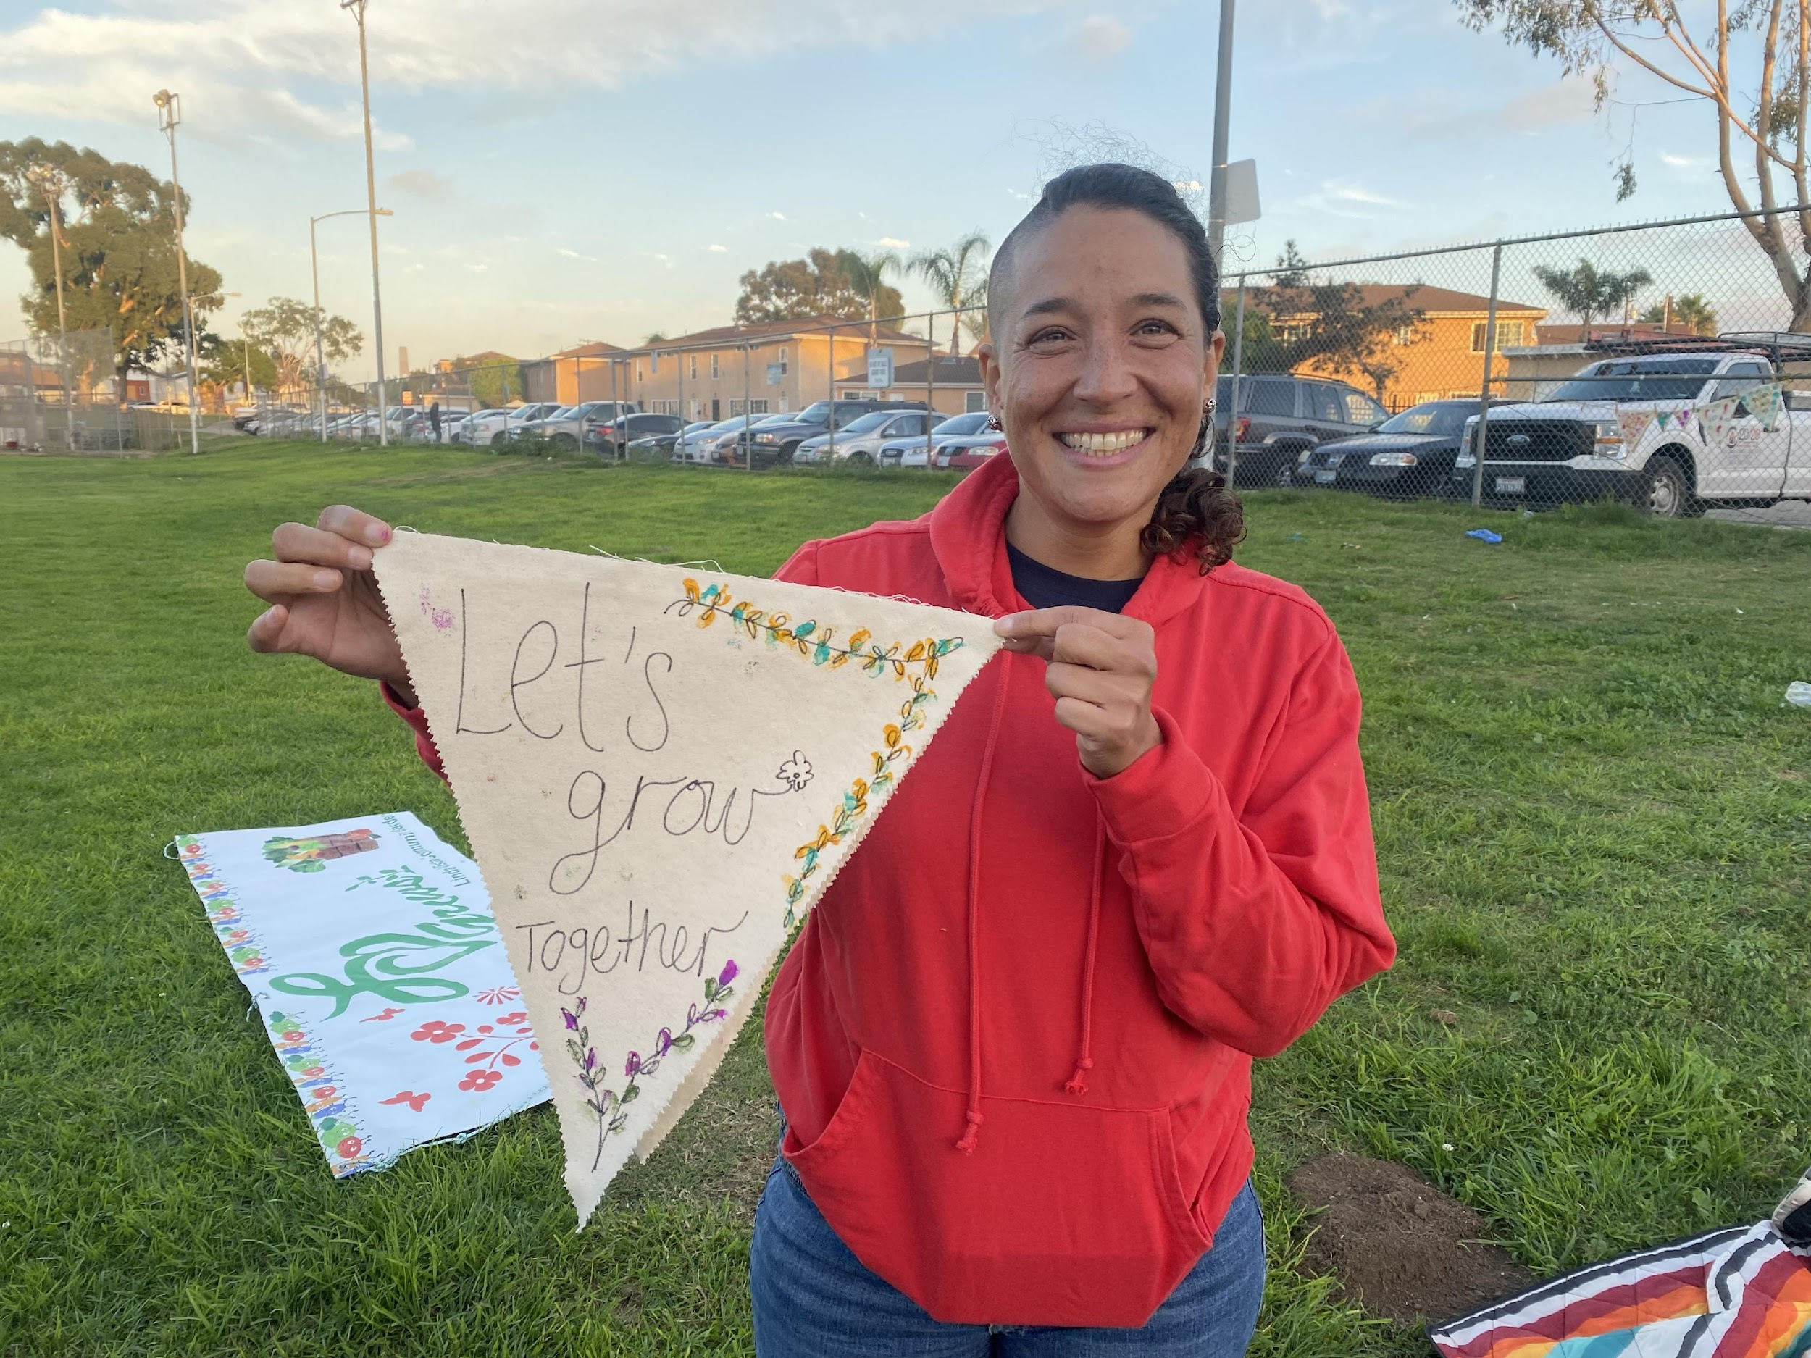
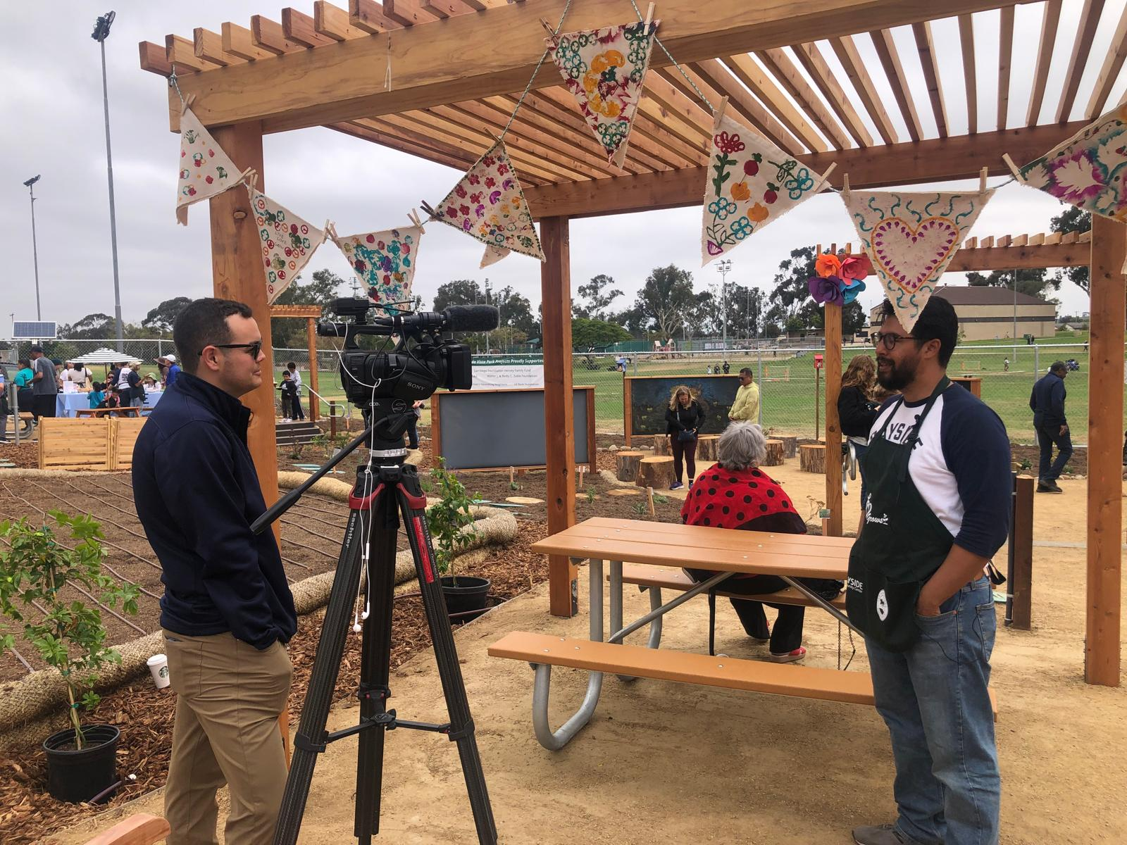
Community Engagement
Asset Mapping & Telling Your Story
  Look for partners with different skills
  Create a Steering Committee
  Information Sign Up Email Form
  Tell everyone your vision.
    Linda Vista Town Council
    Linda Vista Planning Group
    Resident Leadership Academy + Leaders in Action
    Linda Vista Collaborative
    Linda Vista Library
    Parks After Dark
    Linda Vista Multicultural Fair
    Garden Gatherings
    Council Member & Mayors Representatives
    Board of Supervisors
Notes:
1 min
Read slide
>>Attendance at a Garden Gathering is a requirement for entering the Lottery

Slide 17
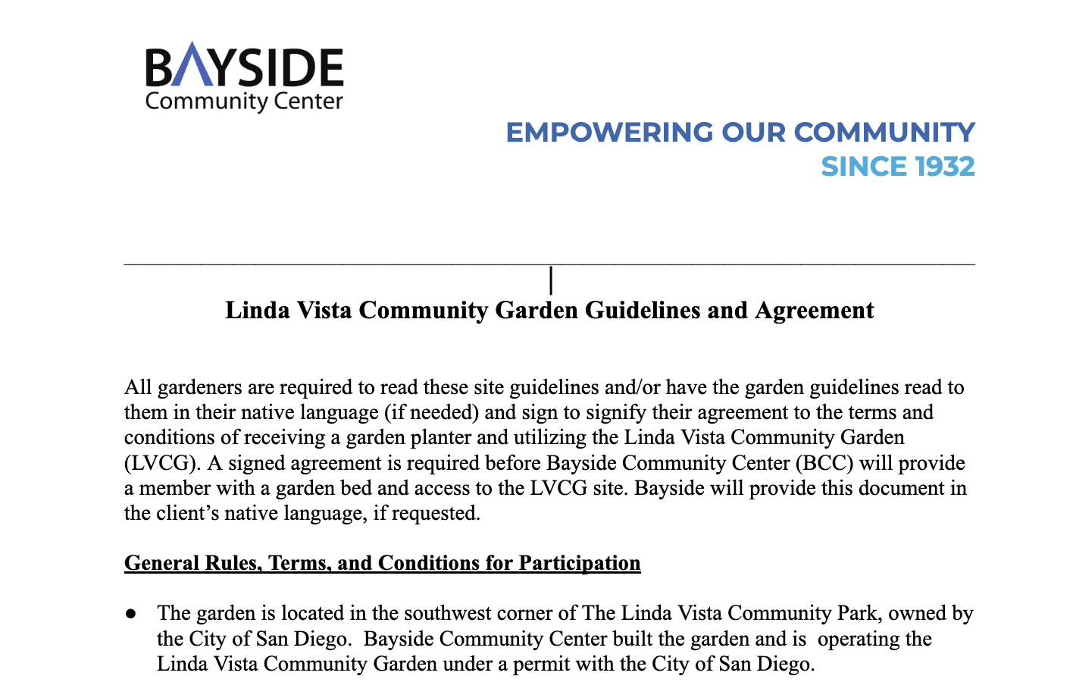
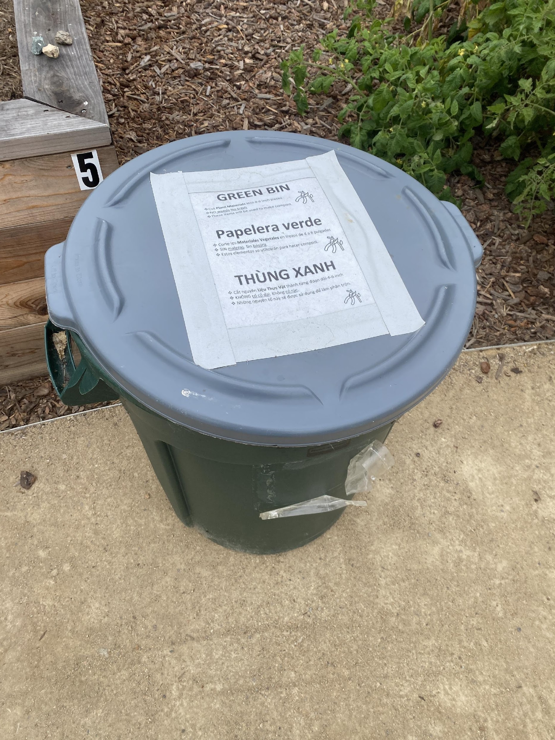
Garden Organization & Management
Steering or Advisory Committee
  Defined roles
  Help create garden operation policy’s, gardener agreement, lottery process, waiting list, manage permits
Clear and Concise Garden Agreement
Liability and Photo release forms
Garden How to Information
Signage everywhere in appropriate languages
  Where to put what !
Encourage garden care-group leaders
Be kind and practice holding grace for everyone
Linda Vista Community Garden /Bayside responsible for operating permit, insurance and liability, rental fee’s etc.
Notes:
2 min

Slide 18
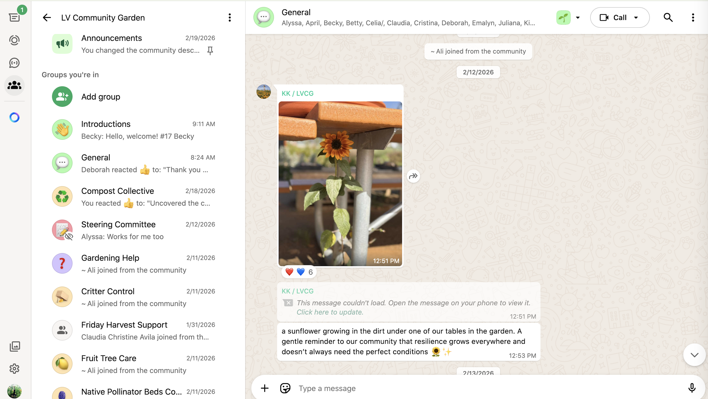
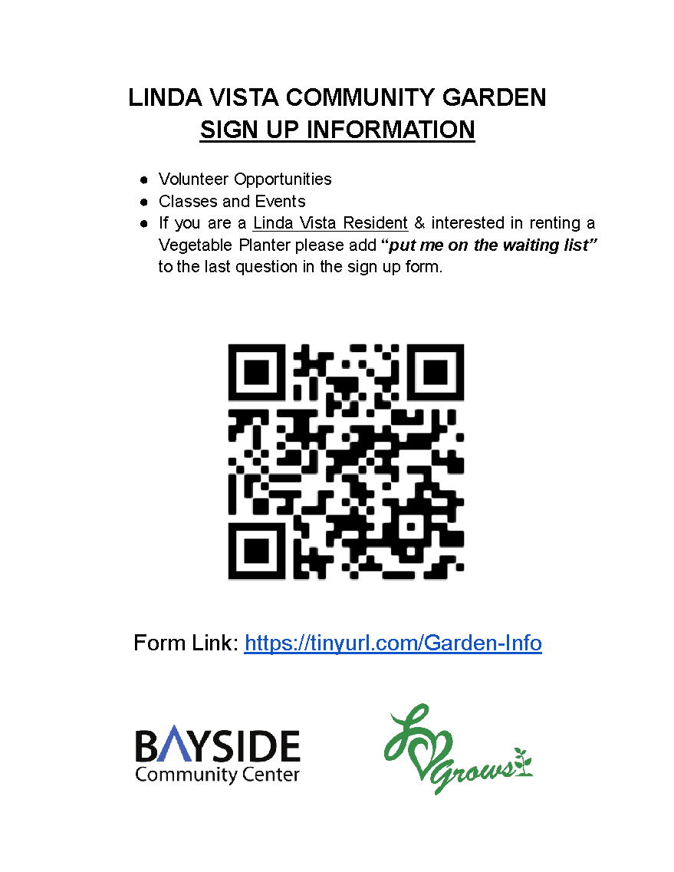
Communication
WhatsApp
Email
Signage on Fences, Sheds
Utilize your steering committee
Translation – Google Translate or Chat GPT, Gemini
Garden Neighbors
Get to know members interests
Notes:
Know as a garden manager your also the cheerleader, listener, - use that to figure our how members could contribute based on garden needs and what they may want to learn.

Slide 19
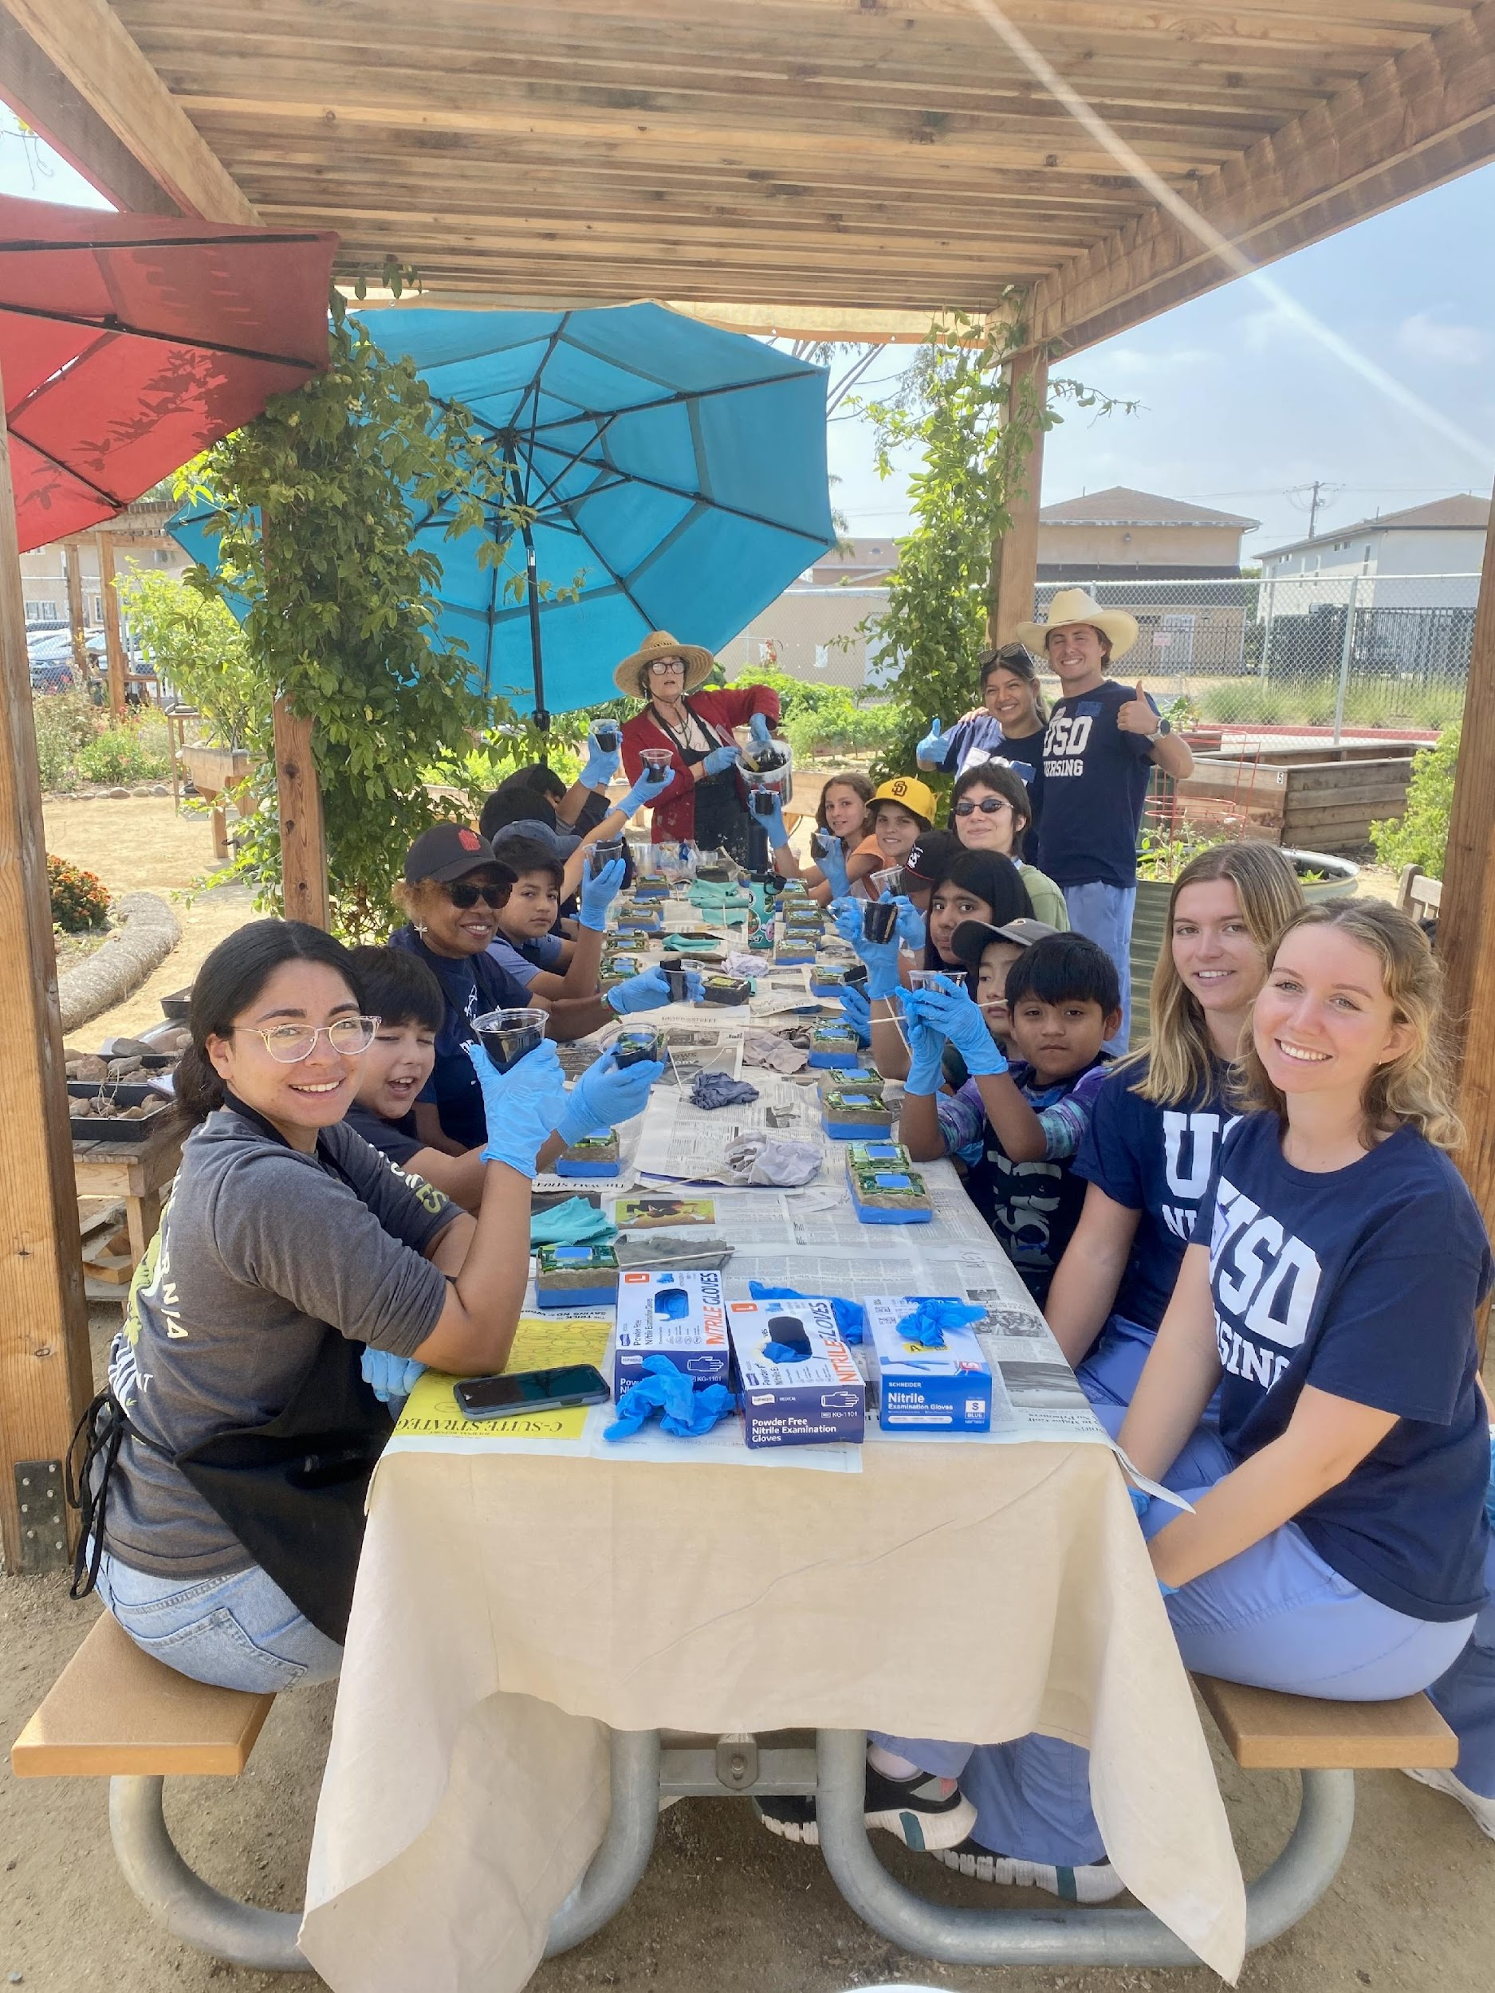
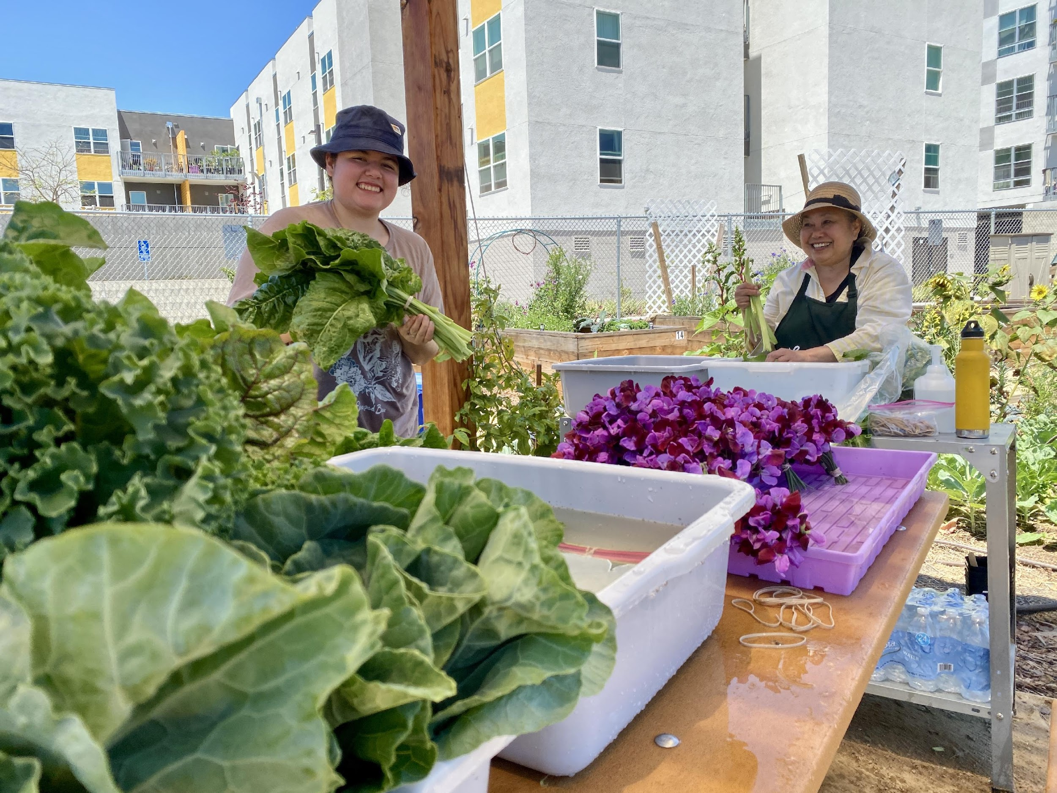
Volunteers & Getting the Word Out
Promote to you email list regularly
Utilize locally community newsletters
Have set days/times people can join – post it on the garden fence
Collaboration Exchange
Local Schools/Institutions/College Core/Interns
Ask for donations to host big groups
Give and Receive Philosophy
Notes:
LV Update - USD Nurses, Grad students wanting interviews exchange for volunteering, community service hours, be organized ! Big group – divide projects ask for who’s feeling what / YMCA Urban Life heavy lifters

Slide 20
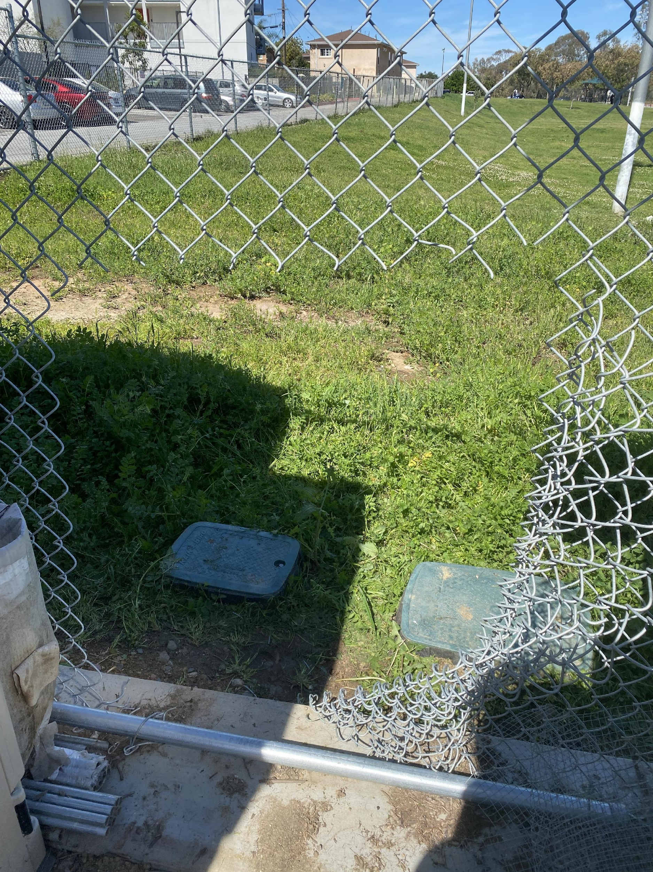
Challenges/Solutions
Theft
Absent Gardeners – Garden Agreements
Garden philosophy's and practices
Irrigation and Water conservation
Pest & Critter management
Onboarding Gardeners & Education
Garden Meetings & Potlucks
Compost Materials & Weeds
Messy areas
Assume people have good intentions
QUESTIONS ?
Notes:
Theft – make friends with the community police officer, the houseless people, the neighbors - give them food in exchange for keeping an eye out.

Slide 21
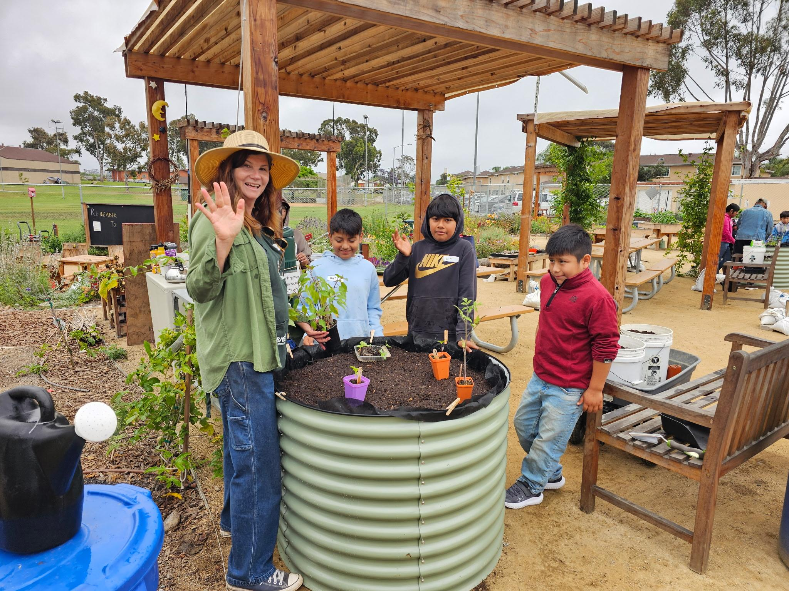
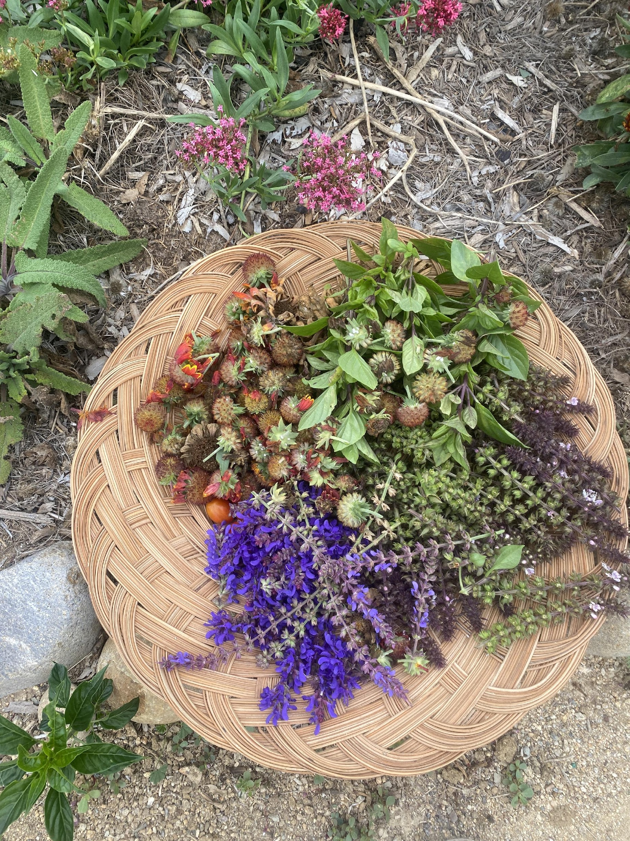
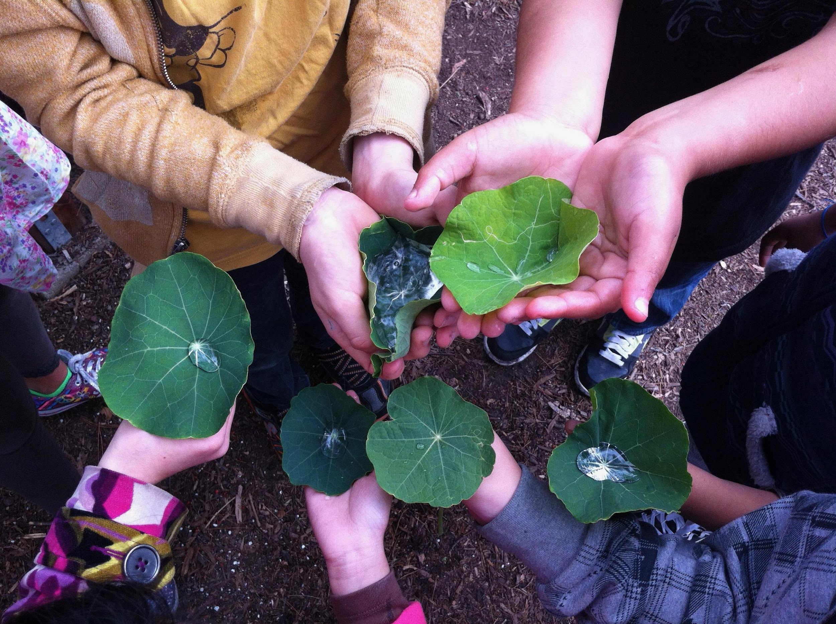
Contact Information
Amy Zink
azink@baysidecc.org
619.300.0713
Notes:
30 sec

